Slide 1
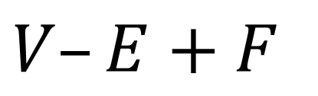

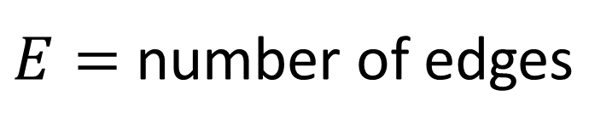
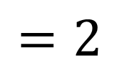

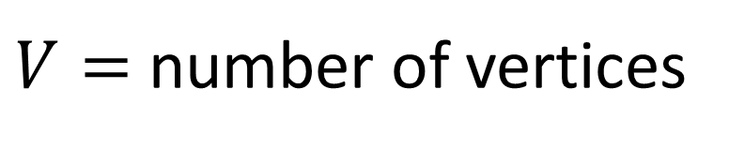
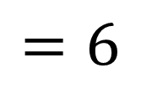

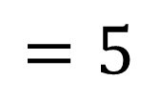
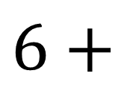
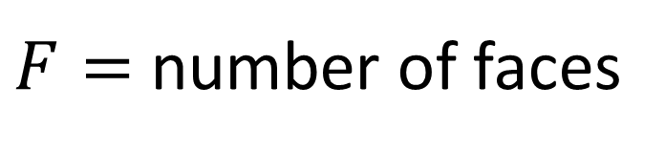
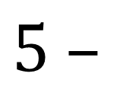
$V=$ number of vertices
$$=5$$
$E=$ number of edges
$$=6$$
$F=$ number of faces
$$=2$$
Now compute:
$$V–E+F$$
$$=$$
$$5 –$$
$$6+$$
$$2$$
$$=1$$

Slide 2
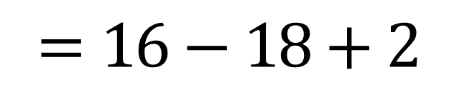
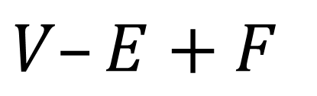
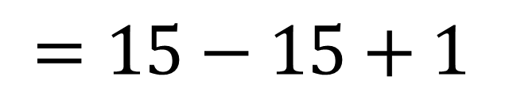
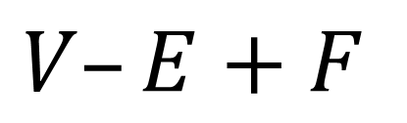

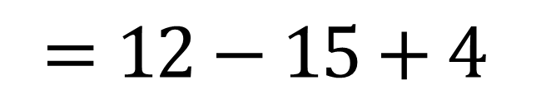
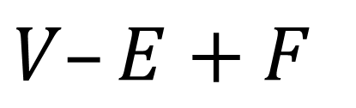

$$V–E+F$$
$$V–E+F$$
$$V–E+F$$
$$=12−15+4$$
$$=15−15+1$$
$$=16−18+2$$
$$=1$$
$$=1$$
$$=0$$

Slide 3






$$V–E+F$$
$$V–E+F$$
$$V–E+F$$
$$12$$
$$1$$
$$6$$
$$14$$
$$=12−15+4$$
$$=15−15+1$$
$$=16−18+2$$
$$20$$
$$12$$
$$=1$$
✔
$$=1$$
✔
$$=0$$
✔

Slide 4
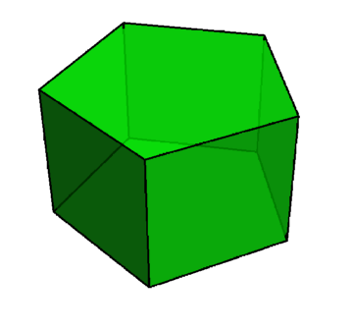
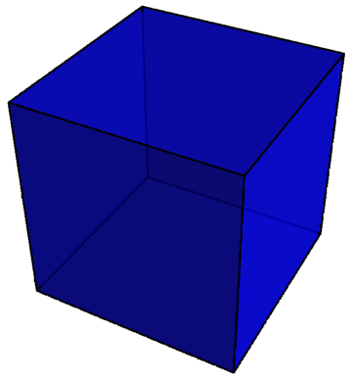
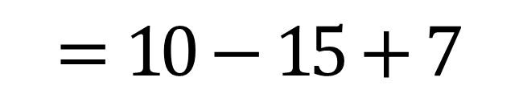
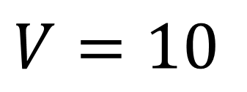
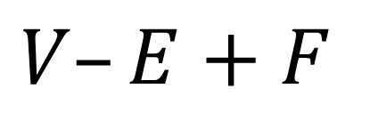
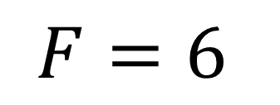

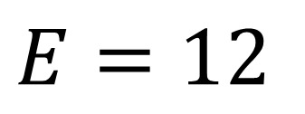
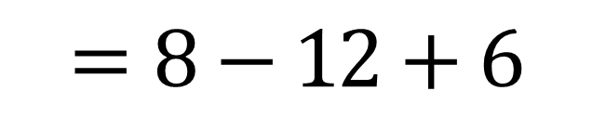
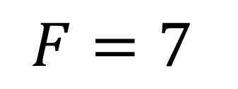
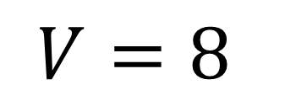
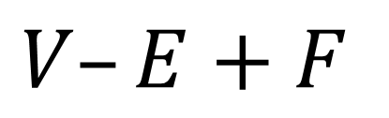

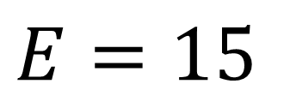
$$V=8$$
$$V=10$$
$$E=12$$
$$E=15$$
$$F=6$$
$$F=7$$
$$V–E+F$$
$$=8−12+6$$
$$V–E+F$$
$$=10−15+7$$
$$=2$$
$$=2$$

Slide 5
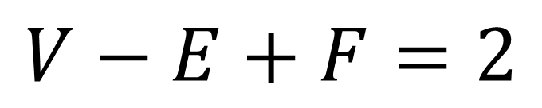
$$V=8$$
Euler’s Polyhedron Formula
$$V=10$$
$$E=12$$
$$E=15$$
$$V−E+F=2$$
$$F=6$$
$$F=7$$
…but does this apply to all polyhedra?
$$V–E+F$$
$$=8−12+6$$
$$V–E+F$$
$$=10−15+7$$
$$=2$$
$$=2$$

Slide 6
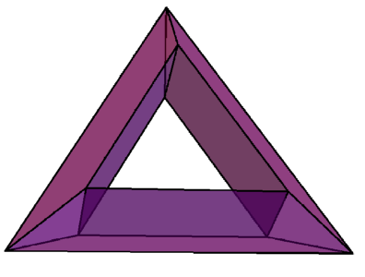
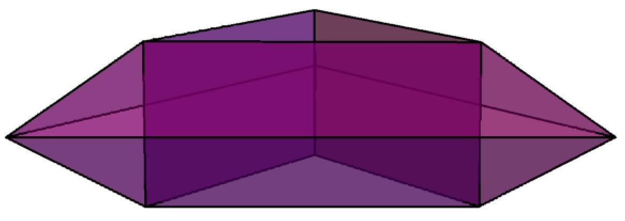
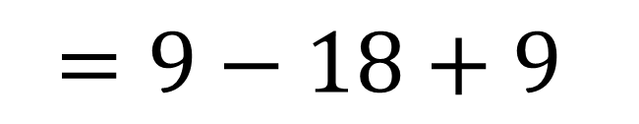
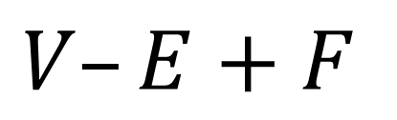
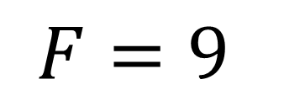
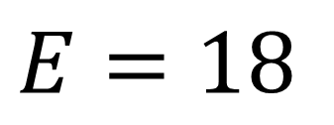
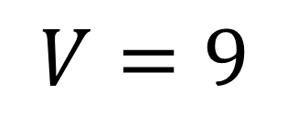

side view:
$$V=9$$
$$E=18$$
$$F=9$$
$$V–E+F$$
$$=9−18+9$$
$$=0$$

Slide 7
Vertices, edges, and faces are examples of cells.
Vertices are 0-cells.
What is a 3-cell?
Edges are 1-cells.
e.g., solid tetrahedron
Faces are 2-cells.
A cell complex consists of cells “glued together” along their boundaries.

Slide 8
A cell complex consists of cells “glued together” along their boundaries.

Slide 9
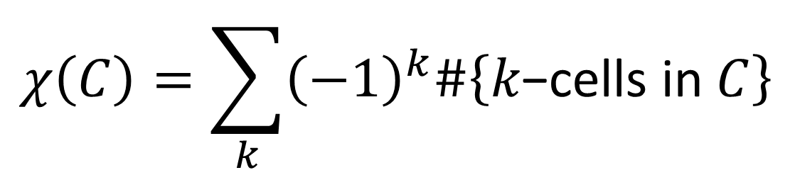
A cell complex consists of cells “glued together” along their boundaries.
cell complex
not a cell complex
Let $C$ be a cell complex. The Euler characteristic of $C$ is:
$$χ\left(C\right)=\sum_{k}{{\left(−1\right)}^{k}\#\left\{k\text{−}\text{cells} \text{in} C\right\}}$$

Slide 10

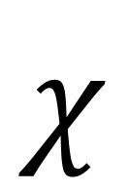
Euler characteristic extends our intuition of counting.
$$χ$$
$$=6$$

Slide 11

Euler characteristic extends our intuition of counting.
$$χ$$
$$=5$$

Slide 12









Euler characteristic extends our intuition of counting.
$$B$$
$$A$$
$$χ\left(A∪B\right)=χ\left(A\right)+χ\left(B\right)−χ\left(A∩B\right)$$
✔
$$5$$
$$=$$
$$4$$
$$+$$
$$3$$
$$−$$
$$2$$

Slide 13
Euler characteristic extends our intuition of counting.
$$B$$
Additive Property
$$A$$
$$χ\left(A∪B\right)=χ\left(A\right)+χ\left(B\right)−χ\left(A∩B\right)$$
✔
$$5$$
$$=$$
$$4$$
$$+$$
$$3$$
$$−$$
$$2$$

Slide 14

Euler characteristic is also expressed in terms of holes.
Topologists study different types of holes:
0-dimensional holes are connected components
1-dimensional holes are holes you can see through
What is a 3-dimensional hole?
2-dimensional holes are voids (enclosed volumes)

Slide 15




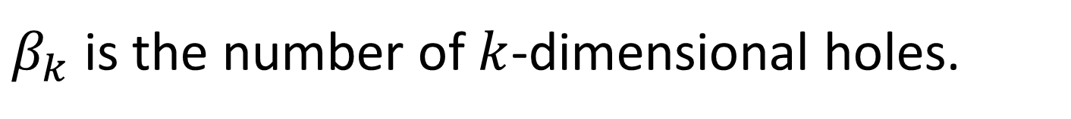






The Betti numbers count holes of a topological object:
$β_{k}$ is the number of $k$-dimensional holes.
Examples:
hollow inside
hollow inside
$$β_{0}=1$$
$$β_{0}=1$$
$$β_{0}=1$$
$$β_{0}=1$$
$$β_{1}=0$$
$$β_{1}=1$$
$$β_{1}=0$$
$$β_{1}=2$$
$$β_{2}=0$$
$$β_{2}=0$$
$$β_{2}=1$$
$$β_{2}=1$$

Slide 16
hollow inside
hollow inside
$$β_{0}=1$$
$$β_{0}=1$$
$$β_{0}=1$$
$$β_{0}=1$$
$$β_{1}=0$$
$$β_{1}=1$$
$$β_{1}=0$$
$$β_{1}=2$$
$$β_{2}=0$$
$$β_{2}=0$$
$$β_{2}=1$$
$$β_{2}=1$$

Slide 17






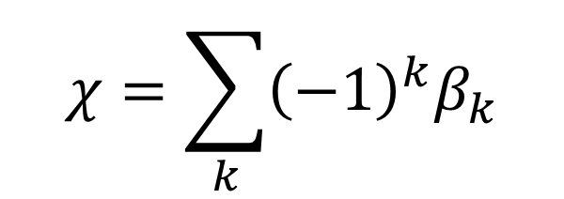








Euler characteristic can be computed in terms of holes:
$$χ=\sum_{k}{{\left(−1\right)}^{k}β_{k}}$$
hollow inside
hollow inside
$$β_{0}=1$$
$$β_{0}=1$$
$$β_{0}=1$$
$$β_{0}=1$$
$$β_{1}=0$$
$$β_{1}=1$$
$$β_{1}=0$$
$$β_{1}=2$$
$$β_{2}=0$$
$$β_{2}=0$$
$$β_{2}=1$$
$$β_{2}=1$$
$$χ=1−0+0=1$$
$$χ=1−1+0=0$$
$$χ=1−0+1=2$$
$$χ=1−2+1=0$$

Slide 18
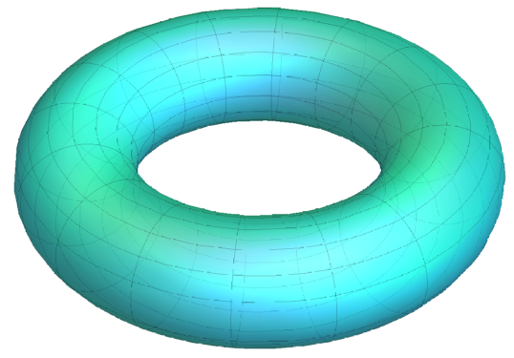
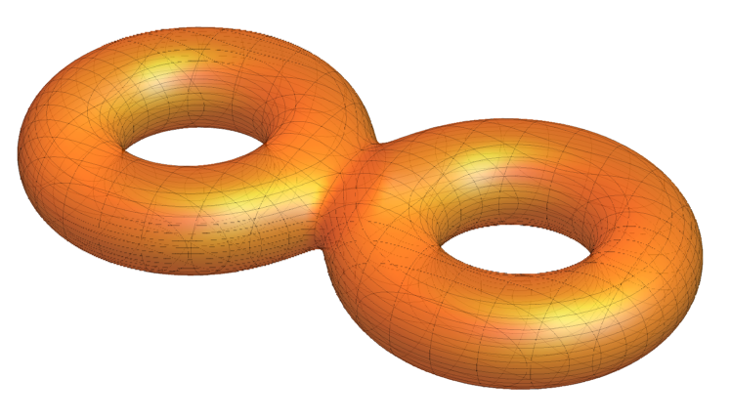










Now we can find the Euler characteristic of smooth objects.
annulus
torus
double torus
hollow inside
hollow inside
$$β_{0}=1$$
$$β_{0}=1$$
$$β_{0}=1$$
$$β_{1}=1$$
$$β_{1}=2$$
$$β_{1}=4$$
$$β_{2}=0$$
$$β_{2}=1$$
$$β_{2}=1$$
$$χ=1−1+0=0$$
$$χ=1−2+1=0$$
$$χ=1−4+1=−2$$

Slide 20
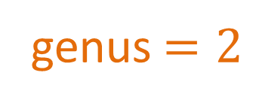

The torus and double torus are examples of surfaces.
genus $=1$
genus $=2$
The genus of a surface is the number of “holes” through the surface.
More precisely, the genus is the maximum number of cuts along non-intersecting simple closed curves that will not make the surface disconnected.

Slide 21
genus $=1$
genus $=2$

Slide 22




genus $=1$
genus $=2$
✔
✔
$$χ=2−2\left(1\right)=0$$
$$χ=2−2\left(2\right)=−2$$
Theorem: For a surface $S$ of genus $g$, $χ\left(S\right)=2 −2g.$

Slide 23


Applications of Euler characteristic:
digital images and shape recognition

Slide 24
Applications of Euler characteristic:
digital images and shape recognition

Slide 25

Applications of Euler characteristic:
digital images and shape recognition

