Slide 1
3D Polyhedral Visibility
(the art gallery problem in 3D)

Slide 2
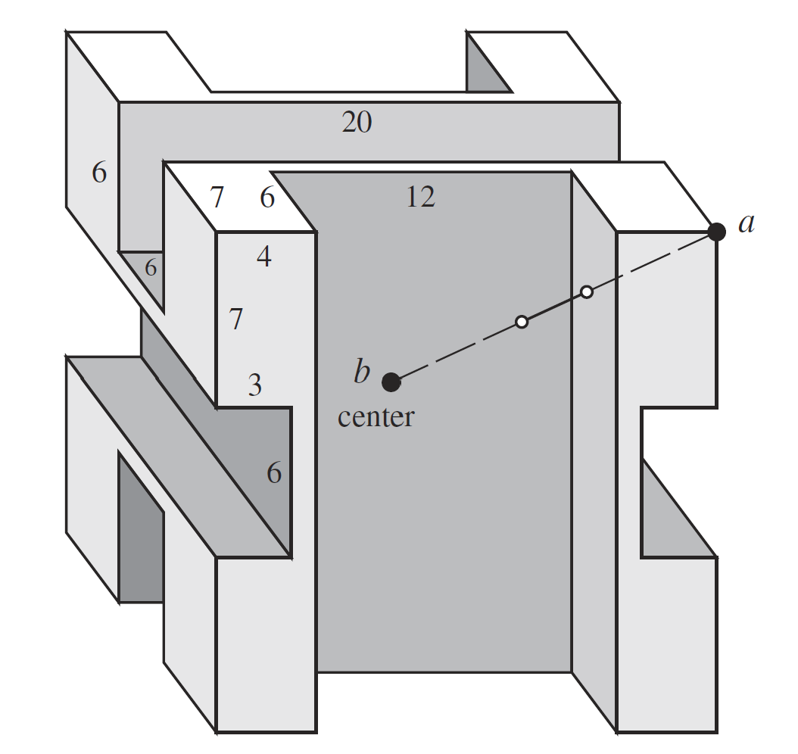
For polyhedra, guards at every vertex might be insufficient
T.S. Michael, “Guards, Galleries, Fortresses, and the Octoplex, The College Mathematics Journal, 42:3, 2011.

Slide 3
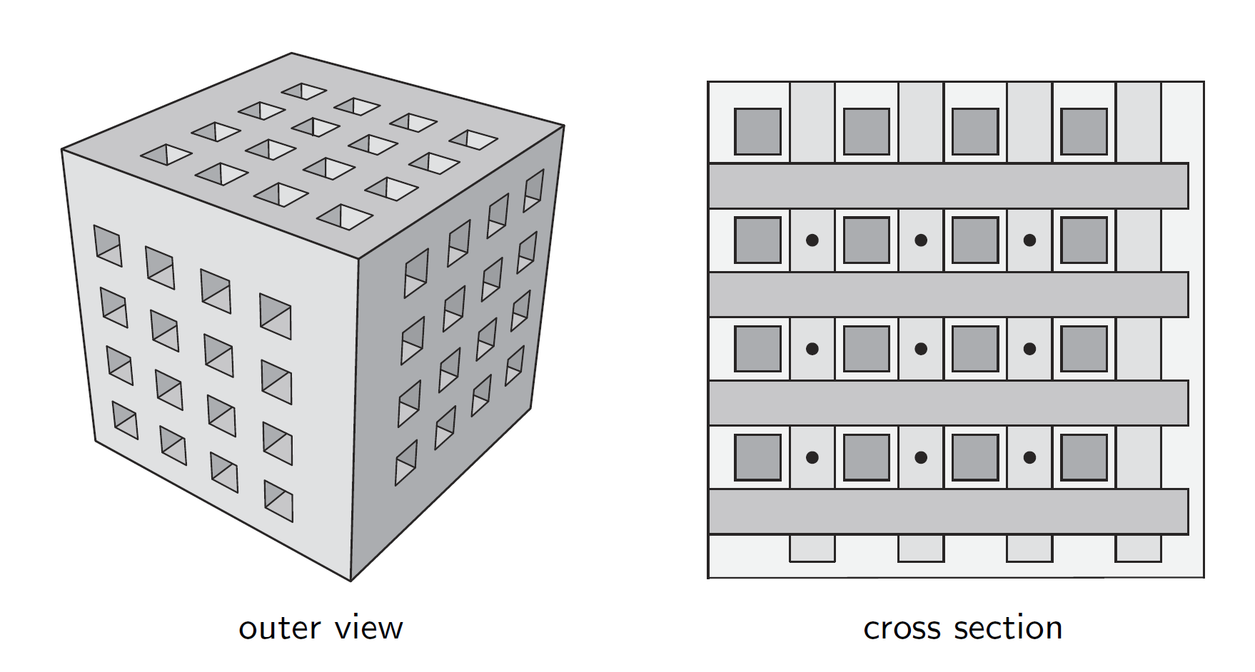
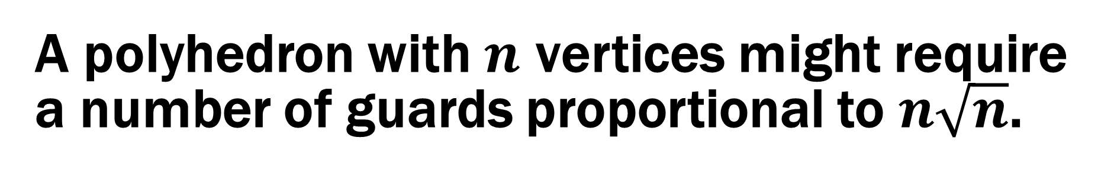
A polyhedron with $n$ vertices might require a number of guards proportional to $n\sqrt{n}$.
vertex guards are insufficient for this polyhedron
Giovanni Viglietta, “Guarding and Searching Polyhedra,” Ph.D. thesis, Universita di Pisa, 2012.

