Slide 1
How Many Ways
are there to
Juggle?
Matthew Wright
slides also by John Chase
4
5
1
4
1
4
5
1
4
1
4
5

Slide 2
Basic Juggling Patterns
Axioms:
The juggler must juggle at a constant rhythm.
Only one throw may occur on each beat of the pattern.
Throws on odd beats must be made from the right hand; throws on even beats from the left hand.
The pattern juggled must be periodic. It must repeat. It must repeat.
All balls must be thrown to the same height.
Example: basic 3-ball pattern (illustrated by a juggling diagram)
arcs represent throws
Here, all throws are 3-throws.
dots represent beats
1
2
3
4
5
6
7
8
9
∙∙∙
R
L
R
L
R
L
R
L
R

Slide 3
Basic 3-ball Pattern
All throws are 3-throws.
Balls land in the opposite hand from which they were thrown.
1
2
3
4
5
6
7
8
9
∙∙∙
R
L
R
L
R
L
R
L
R
Basic 4-ball Pattern
All throws are 4-throws.
Balls land in the same hand from which they were thrown.
1
2
3
4
5
6
7
8
9
∙∙∙
R
L
R
L
R
L
R
L
R

Slide 4


The Basic $b$-ball Patterns
If $b$ is odd:
Each throw lands in the opposite hand from which it was thrown.
These are called cascade patterns.
If $b$ is even:
Each throw lands in the same hand from which it was thrown.
These are called fountain patterns.

Slide 5
Let’s change things up a bit…
Axioms:
The juggler must juggle at a constant rhythm.
Only one throw may occur on each beat of the pattern.
Throws on even beats must be made from the right hand; throws on odd beats from the left hand.
The pattern juggled must be periodic. It must repeat. It must repeat.
All balls must be thrown to the same height.
What if we allow throws of different heights?
Axioms 1-4 describe the simple juggling patterns.

Slide 6
Example
We can make a 4-throw, then a 4-throw, then a 1-throw, and repeat:
4
4
4
4
4
4
1
1
1
1
2
3
4
5
6
7
8
9
∙∙∙
We call this pattern 4, 4, 1 (often written 441).
This is an example of a juggling sequence: a (finite) sequence of nonnegative integers corresponding to a simple juggling pattern.

Slide 7
The sequence 501 is a juggling sequence:
5
5
5
5
1
1
1
1
0
0
0
0
1
2
3
4
5
6
7
8
9
10
11
12
∙∙∙
This sequence is juggled with only two balls!
The period of this sequence is 3.
This sequence is minimal, since it has the smallest period among all juggling sequence that represent this pattern.

Slide 8

Is every nonnegative integer sequence a juggling sequence?
No.
Consider the sequence 54:
5
4
collision!
A 5-throw followed by a 4-throw results in a collision.
In general, an $n$-throw followed by an $(n−1)$-throw results in a collision.

Slide 9
The sequence 311 is not a juggling sequence.
∙∙∙
3
1
1
3
1
1
3
1
1
∙∙∙
How can we tell if a sequence is a juggling sequence?
Draw its juggling diagram and check that:
At each dot, either exactly one arch ends and one starts, or no arches end and start; and
All dots with no arches correspond to 0-throws.

Slide 10
Examples of Juggling Sequences
2-balls: 31, 312, 411, 330, 501
3-balls: 441, 531, 51, 4413, 45141
4-balls: 5551, 53, 534, 633, 71
5-balls: 66661, 744, 75751
4
5
1
4
1
4
5
1
4
1
4
5
∙∙∙

Slide 11
Transforming Juggling Sequences
Start with the basic 4-ball pattern:
5
3
4
4
4
4
4
4
4
4
4
Concentrate on the landing sites of two throws.
Now swap them!
The first 4-throw will land a beat later, making it a 5-throw.
The second 4-throw will land a beat earlier, making it a 3-throw.
This is the swap operation (also called a “site swap”).

Slide 12
Example: Swap the second and third elements of 4413.
∙∙∙
4
4
1
3
4
4
1
3
∙∙∙
We can’t just interchange the 4 and 1, because 4143 is not a juggling sequence.
∙∙∙
4
1
4
3
4
1
4
3
∙∙∙

Slide 13
Example: Swap the second and third elements of 4413.
4 4 1 3
4 4 1 3
∙∙∙
4
4
1
3
4
4
1
3
∙∙∙
+1
‒1
Interchange the landing positions of the second and third throws:
+1
‒1
4 2 3 3
4 2 3 3
∙∙∙
4
2
3
3
4
2
3
3
∙∙∙

Slide 14
Example: Swap the second and third elements of 4413.
4 4 1 3
4 4 1 3
∙∙∙
4
4
1
3
4
4
1
3
∙∙∙
+1
‒1
Interchange the landing positions of the second and third throws:
+1
‒1
4 2 3 3
4 2 3 3
∙∙∙
4
2
3
3
4
2
3
3
∙∙∙
The swap operation is its own inverse.

Slide 15
?
How do we know if a given sequence is a juggling sequence?
For instance, is 6831445 a jugglable sequence?

Slide 16

The Transformation Theorem
Theorem: Any juggling sequence can be transformed into a constant juggling sequence using swaps. Conversely, any juggling sequence can be constructed from the constant juggling sequence using swaps.
Application: Let $S$ be any finite sequence of nonnegative integers. $S$ is a juggling sequence if and only if it can be transformed to a constant sequence by swaps.

Slide 17


Lemma: Let $S$ be a finite sequence of nonnegative integers. Let $S′$ be the sequence that results from applying a swap to $S$. Then $S′$ is a juggling sequence if and only if $S$ is a juggling sequence.
Why?
If $S$ is a juggling sequence, then applying a swap to $S$ will not cause a collision.
swap

Slide 18

The Flattening Algorithm
Let $S$ be a sequence of $p ≥ 1$ nonnegative integers:
$$S: a_{1}, a_{2}, …, a_{p}$$
The flattening algorithm transforms $S$ into a new sequence as follows:
If $S$ is a constant sequence, stop and output this sequence. Otherwise,
use cyclic shifts to arrange the elements of $S$ such that a maximum integer in $S$, say $m$, is at position 1 and a non-maximum integer in $S$, say $n$, is at position 2. If $m=n+1$, stop and output this sequence. Otherwise,
perform a site swap of positions 1 and 2. Redefine $S$ to be the resulting sequence, and return to step 1.

Slide 19

The Flattening Algorithm
Example: start with the sequence 642
also jugglable!
swap
shift
swap
shift
swap
jugglable!
642
552
525
345
534
444
Example: start with the sequence 514
also not jugglable
swap
shift
swap
shift
not jugglable
514
244
424
334
433
Observe: The Flattening Algorithm can be used to decide whether or not a sequence is a juggling sequence:
If the input is a $b$-ball juggling sequence with period $p$, this algorithm outputs the basic $b$-ball sequence of period $p$.
If the input is not a juggling sequence, the algorithm outputs a sequence of the form $m, m – 1, …$.
This proves the Transformation Theorem.

Slide 20



How many balls are required to juggle a given sequence?
The Average Theorem: The number of balls necessary to juggle a juggling sequence is the average of the numbers in the sequence.
Proof: Let $S$ be a juggling sequence.
Apply the Flattening Algorithm to $S$, obtaining the constant $b$-ball sequence for some $b$.
The swap operation preserves both the number of balls and the average of a juggling sequence.
The average of the constant $b$-ball sequence is $b$, and this sequence requires $b$ balls.
$$S:a_{1},a_{2},…,a_{p}$$
Flattening Algorithm
$$b,b,…,b$$
Thus, sequence $S$ also has average $b$ and requires $b$ balls.

Slide 21
How many balls are required to juggle a given sequence?
The Average Theorem: The number of balls necessary to juggle a juggling sequence is the average of the numbers in the sequence.
Corollary: A juggling sequence must have an integer average.
Examples:
534
441
7531
75751
352
4-ball pattern
3-ball pattern
4-ball pattern
5-ball pattern
not jugglable!

Slide 22
Interlude: Modular Arithmetic
In arithmetic modulo n, we reduce numbers to their remainder after division by n.
Examples:
7 modulo 5 is equal to 2
9 modulo 4 equals 1
7 (mod 5) = 2
9 (mod 4) = 1
You frequently use modular arithmetic when you think about time.
12
What time is 4 hours after 10:00?
9
3
10 + 4 (mod 12) = 2
so it will be 2:00
6

Slide 23


How do we know if a given sequence is a juggling sequence?
Theorem: Let $S =a_{0},a_{1},…,a_{p−1}$, be a sequence of nonnegative integers and let $[p] = \{0, 1, 2, …, p − 1\}$.
Then, $S$ is a juggling sequence if and only if the function $φ_{S}:\left[p\right]→\left[p\right]$ defined
$$φ_{S}(i) = i + ai (mod p)$$
is a permutation of the set $\left[p\right]$.
Observe: The ball thrown on beat $i$ lands on beat $φ_{S}\left(i\right)$ $(mod p)$.

Slide 24


Theorem: Let $S: a_{0},a_{1},…,a_{p−1}$, be a sequence of nonnegative integers and let $\left[p\right] = \left\{0, 1, 2, …, p − 1\right\}$. Then, $S$ is a juggling sequence if and only if the function $φ_{S}:\left[p\right]→\left[p\right]$ defined
$$φ_{S}\left(i\right) = i + ai \left(mod p\right)$$
is a permutation of the set $\left[p\right]$.
Example: Show 534 is a juggling sequence.
Let $S:5, 3, 4$. The period is 3, so $p=3$. Note $\left[p\right]=\left\{0,1,2\right\}$.
Then $\left\{φ_{S}\left(0\right),φ_{S}\left(1\right),φ_{S}\left(2\right)\right\}$
$=\left\{0+5, 1+3, 2+4\right\} \left(mod 3\right)$
$=\left\{5, 4, 6\right\} (mod 3)=\left\{2, 1, 0\right\}$
This is a permutation of $\left[p\right]$, so 534 is a juggling sequence.

Slide 25


Theorem: Let $S: a_{0},a_{1},…,a_{p−1}$, be a sequence of nonnegative integers and let $\left[p\right] = \left\{0, 1, 2, …, p − 1\right\}$. Then, $S$ is a juggling sequence if and only if the function $φ_{S}:\left[p\right]→\left[p\right]$ defined
$$φ_{S}\left(i\right) = i + ai \left(mod p\right)$$
is a permutation of the set $\left[p\right]$.
Example: Is 8587 a valid juggling sequence?
Let $S:8, 5, 8, 7$. Then $p=4$ and $\left[p\right]=\left\{0, 1, 2, 3\right\}$.
Then $\left\{φ_{S}\left(0\right),φ_{S}\left(1\right),φ_{S}\left(2\right),φ_{S}\left(3\right)\right\}$
$=\left\{0+8, 1+5, 2+8, 3+7\right\} \left(mod 4\right)$
$=\left\{8, 6, 10, 10\right\} (mod 4)=\left\{0, 2, 2, 2\right\}$
This is not a permutation of $\left[p\right]$, so 8587 is not a juggling sequence.

Slide 26

Theorem: Let $S: a_{0},a_{1},…,a_{p−1}$, be a sequence of nonnegative integers and let $\left[p\right] = \left\{0, 1, 2, …, p − 1\right\}$. Then, $S$ is a juggling sequence if and only if the function $φ_{S}:\left[p\right]→\left[p\right]$ defined
$$φ_{S}\left(i\right) = i + ai \left(mod p\right)$$
is a permutation of the set $\left[p\right]$.
Proof: The function $φ_{S}$ is a permutation if and only if the vector
$$v=\left(φ_{S}\left(0\right),φ_{S}\left(1\right),φ_{S}\left(2\right), …,φ_{S}(p−1)\right)$$
contains all of the integers from $0$ to $p – 1$.
Suppose we apply swaps to the sequence $S$ to obtain sequence $S′$ with corresponding vector $v′$. Then $v′$ contains all of the elements of $\left[p\right]$ if and only if $v$ does.
Therefore, given a sequence $S$, apply the flattening algorithm to obtain $S′$. Then $S$ is a juggling sequence if and only if $S′$ is a constant sequence, if and only if $v′$ contains all of the elements of $\left[p\right]$.

Slide 27

?
How many ways are there to juggle?
Infinitely many.
(Consider the basic $b$-ball sequences for each integer $b∈ℕ$.)
How many $b$-ball juggling sequences are there with period $p$?

Slide 28



How many $n$-ball juggling sequences are there of period $n$?
$n=1$: There is one unique sequence, namely, 1.
1
$n=2$: Starting with the sequence 22, we can perform site swaps to obtain two other sequences, 31 and 40 (unique up to cyclic shifts).
2 2
3 1
4 0
$n=3$: Starting with 333 and performing site swaps, we (eventually) obtain 13 sequences (unique up to cyclic shifts).

Slide 29
How many $n$-ball juggling sequences are there of period $n$?
3
3
1
5
3
3
4
2
4
4
0
4
1
0
5
3
5
3
0
3
6
0
6
2
2
7
2
0
8
1
1
0
9
0
1
7
1
2
6
$n=3$: Starting with 333 and performing site swaps, we (eventually) obtain 13 sequences (unique up to cyclic shifts).

Slide 30
Is there a better way to count juggling sequences?
Suppose we have a large number of each of the following juggling cards:
These cards can be used to construct all juggling sequences that are juggled with at most three balls.

Slide 31
Example: juggling sequence 441
juggling diagram
∙∙∙
4
4
1
4
4
1
4
4
1
∙∙∙
constructed with juggling cards
4
4
1
4
4
1
4
4
1

Slide 32
Counting Juggling Sequences
With many copies of these four cards, we can construct any (not-necessarily minimal) juggling sequences that is juggled with at most three balls.
0-throw
ball that lands is the one that was most recently thrown
ball that lands is the one that was second-most recently thrown
ball that lands is the one that was least recently thrown

Slide 33

Counting Juggling Sequences
With many copies of these four cards, we can construct any (not-necessarily minimal) juggling sequences that is juggled with at most three balls.
Similarly, with many copies of $b+1$ distinct cards, we can construct any (not-necessarily minimal) juggling sequence that is juggled with at most $b$ balls.
Lemma: The number of all juggling sequences of period $p$, juggled with at most $b$ balls, is:
$$S^{≤}\left(b,p\right)={\left(b+1\right)}^{p}$$

Slide 34


Counting Juggling Sequences
Lemma: The number of all juggling sequences of period $p$, juggled with at most $b$ balls, is:
$$S^{≤}\left(b,p\right)={\left(b+1\right)}^{p}$$
It follows that:
Lemma: The number of all $b$-ball juggling sequences of period $p$ is:
$$S\left(b,p\right)=S^{≤}\left(b,p\right) –S^{≤}\left(b−1,p\right)={\left(b+1\right)}^{p}−b^{p}$$
However, we have counted each cyclic permutation of every sequence, as well as non-minimal sequences.
How can we count the minimal $b$-ball juggling sequences of period $p$, not counting cyclic permutations of the same sequence as distinct?

Slide 35



Counting Juggling Sequences
We know: The number of all (not necessarily minimal) $b$-ball juggling sequences of period $p$ is:
$$S\left(b,p\right)={\left(b+1\right)}^{p}−b^{p}.$$
Definition: Let $M\left(b,p\right)$ be the number of minimal $b$-ball juggling sequence of period $p$, not counting cyclic permutations as distinct.
Observe: If $d$ divides $p$, then each minimal juggling sequence of period $d$ gives rise to exactly $d$ sequences of period $p$. Thus,
$$S\left(b,p\right)=\sum_{d|p}{d M\left(b,d\right)}.$$
Question: How can we solve for $M\left(b,d\right)$?

Slide 36
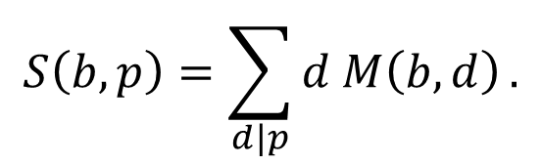
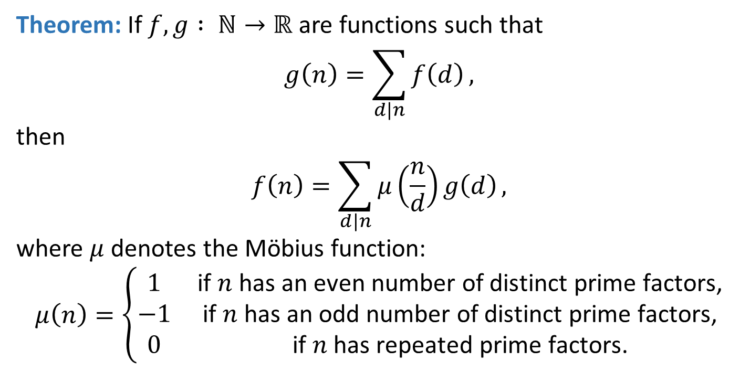
Interlude: Möbius Inversion
Theorem: If $f,g : ℕ→ℝ$ are functions such that
$$g\left(n\right)=\sum_{d|n}{f\left(d\right)},$$
then
$$f\left(n\right)=\sum_{d|n}{μ\left(\frac{n}{d}\right)g\left(d\right)},$$
where $μ$ denotes the Möbius function:
$$μ\left(n\right)=\left\{\begin{matrix}1 & \text{if} n \text{has} \text{an} \text{even} \text{number} \text{of} \text{distinct} \text{prime} \text{factors}\text{,} \\ −1 & \text{if} n \text{has} \text{an} \text{odd} \text{number} \text{of} \text{distinct} \text{prime} \text{factors}\text{,} \\ 0 & \text{if} n \text{has} \text{repeated} \text{prime} \text{factors}\text{.}\end{matrix}\right.$$
$$S\left(b,p\right)=\sum_{d|p}{d M\left(b,d\right)}.$$
Observe: This allows us to “invert”

Slide 37

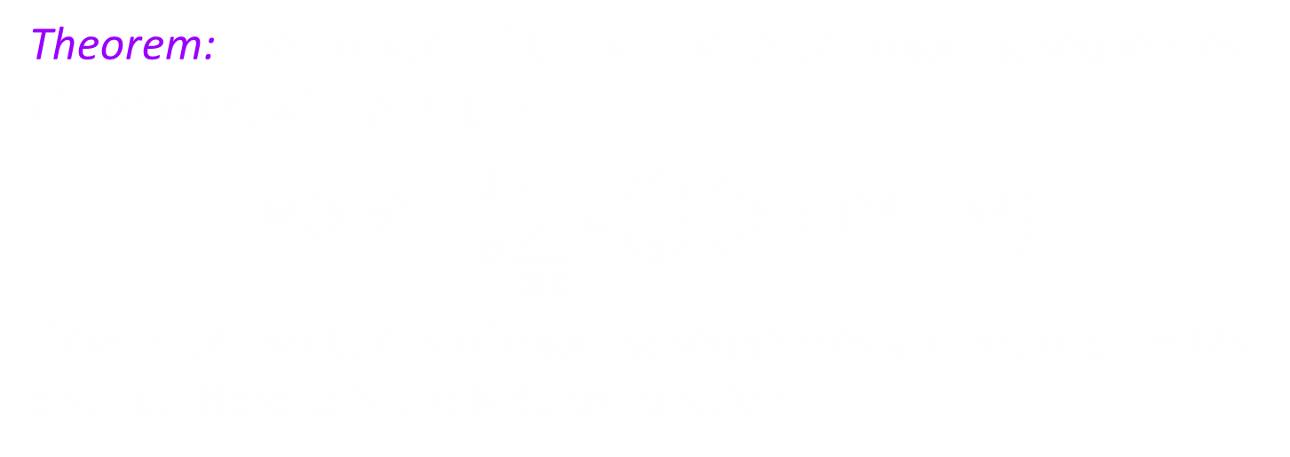
Counting Juggling Sequences
Theorem: The number of all minimal $b$-ball juggling sequences of period $p$, with $b≥1$, is
$$M\left(b,p\right)=\frac{1}{p}\sum_{d|p}{μ\left(\frac{p}{d}\right)\left({\left(b+1\right)}^{d}−b^{d}\right)}$$
if cyclic permutations of juggling sequences are not counted as distinct. Here, $μ$ is the Möbius function.
Proof: The expression for $M\left(b,p\right)$ follows from
$$S\left(b,p\right)={\left(b+1\right)}^{p}−b^{p}=\sum_{d|p}{dM\left(b,d\right)}$$
and Möbius inversion.

Slide 38

Counting Juggling Sequences
Counts of minimal $b$-ball juggling sequences for small periods $p$:
$$M\left(b,1\right)=1$$
$$M\left(b,2\right)=b$$
$$M\left(b,3\right)=b\left(b+1\right)$$
$$M\left(b,4\right)=b\left(b^{2}+b+1\right)$$
$$M\left(b,5\right)=b\left(b^{3}+2b^{2}+2b+1\right)$$

Slide 39
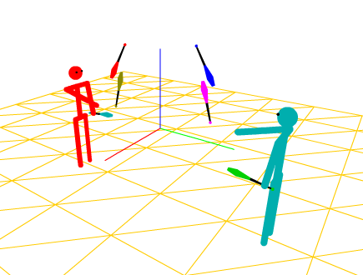
Juggling Simulators
Many software programs are available to simulate juggling:
jugglinglab.sourceforge.net
www.siteswap.net/JsJuggle.html
www.juggloid.com

Slide 40
?
Questions?

Slide 41
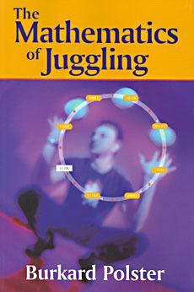
Reference:
Burkard Polster. The Mathematics of Juggling. Springer, 2003.
Juggling Simulators:
jugglinglab.sourceforge.net
www.siteswap.net/JsJuggle.html
www.juggloid.com/

