Slide 1
Hadwiger Integration and Applications
Matthew Wright
Institute for Mathematics and its Applications
University of Minnesota
Applied Topology in Będlewo
July 24, 2013

Slide 2
How can we assign a notion of size to functions?
Lebesgue integral
Anything else?

Slide 3
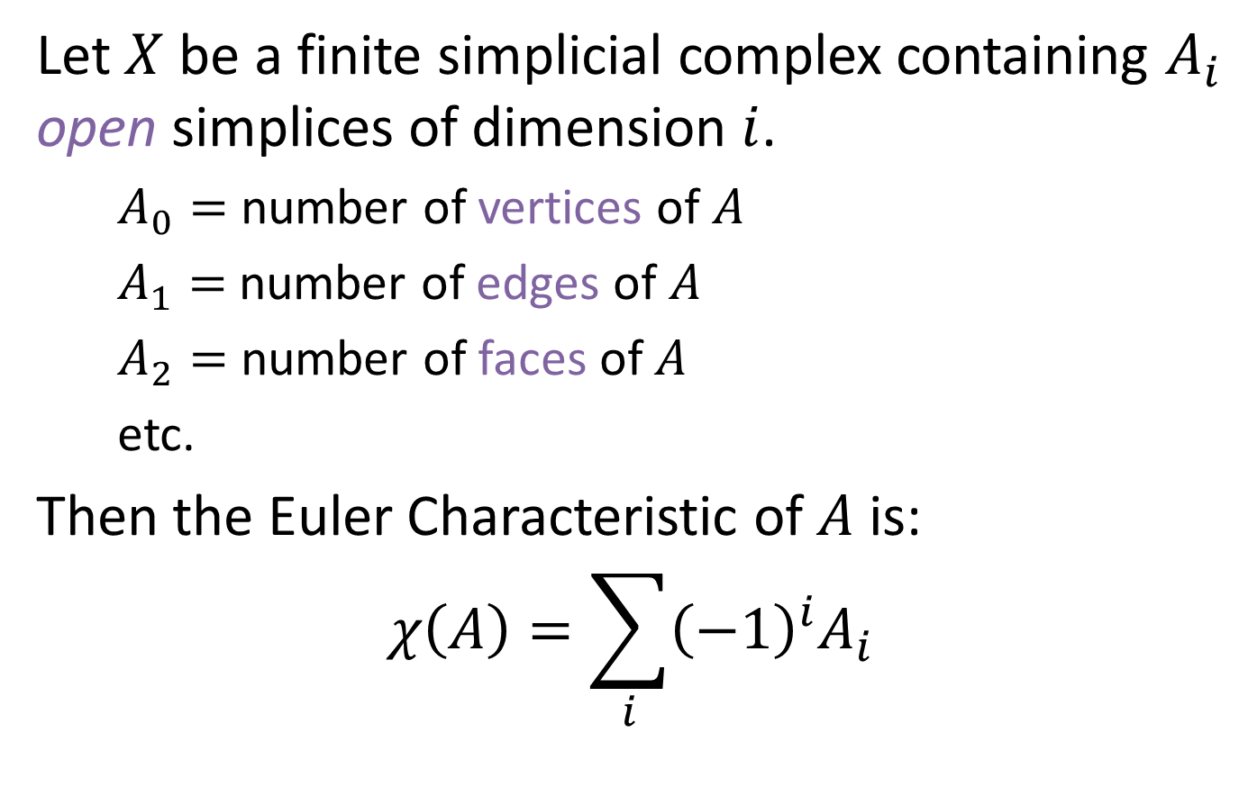
Euler Characteristic
Let $X$ be a finite simplicial complex containing $A_{i}$ open simplices of dimension $i$.
$A_{0}=$ number of vertices of $A$
$A_{1}=$ number of edges of $A$
$A_{2}=$ number of faces of $A$
etc.
Then the Euler Characteristic of $A$ is:
$$χ\left(A\right)=\sum_{i}{{\left(−1\right)}^{i}A_{i}}$$
v
combinatorial

Slide 4

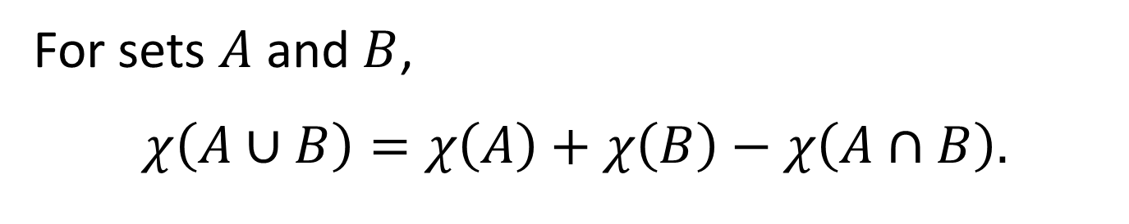


Key Property
For sets $A$ and $B$,
$$χ\left(A∪B\right)=χ\left(A\right)+χ\left(B\right)−χ\left(A∩B\right).$$
This property is called additivity, or the inclusion-exclusion principle.
$$A$$
$$A∩B$$
$$B$$

Slide 5

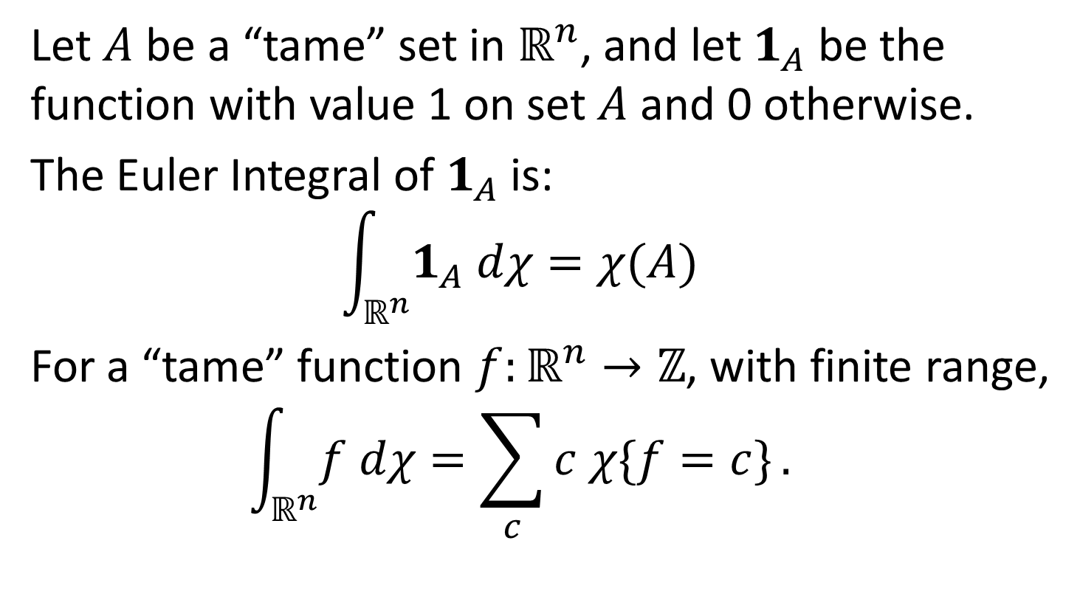
Euler Integral
Let $A$ be a “tame” set in $ℝ^{n}$, and let $1_{A}$ be the function with value 1 on set $A$ and 0 otherwise.
The Euler Integral of $1_{A}$ is:
$$\int_{ℝ^{n}}^{ }{1_{A} dχ}=χ(A)$$
For a “tame” function $f:ℝ^{n}→ℤ$, with finite range,
$$\int_{ℝ^{n}}^{ }{f dχ}=\sum_{c}^{ }{c χ\{f=c\}}.$$
set on which $f=c$

Slide 6

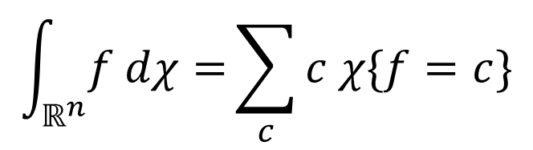







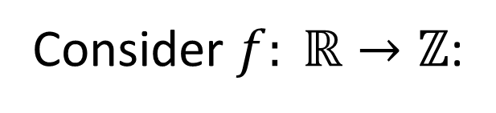


Example
Consider $f: ℝ→ℤ$:
$$\int_{ℝ^{n}}^{ }{f dχ=}\sum_{c}^{ }{c χ\{f=c\}}$$
3
$$f(x)$$
$$=1⋅0$$
$$←c=1$$
2
$+ 2⋅(−1)$
$$←c=2$$
$$+ 3⋅2$$
$$←c=3$$
1
$$=4$$
$$x$$
Euler integral of $f$

Slide 7


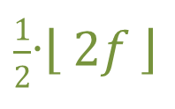

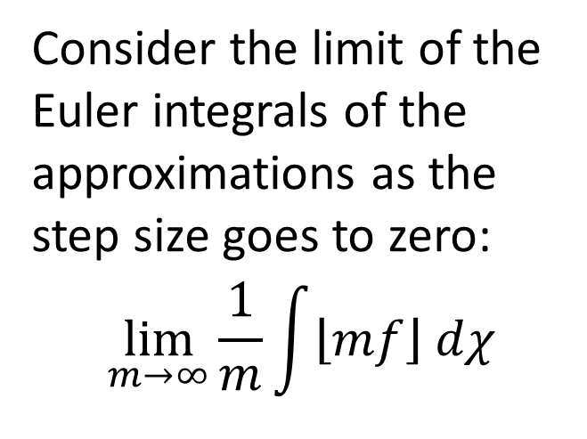


Continuous Functions
How can we extend the Euler integral to a continuous function $f: ℝ→ℝ$?
Idea: Approximate $f$ by step functions.
$$f$$
Make the step size smaller.
3
$$\left\lfloor f \right\rfloor$$
Consider the limit of the Euler integrals of the approximations as the step size goes to zero:
$$\lim_{m→∞}{\frac{1}{m}\int{\left\lfloor mf\right\rfloor dχ}}$$
$\frac{1}{2}$∙$\left\lfloor 2f \right\rfloor$
2
1
$$x$$
Does it matter if we use lower or upper approximations?

Slide 8
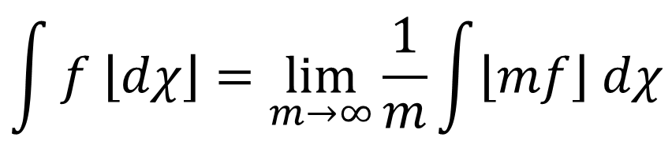
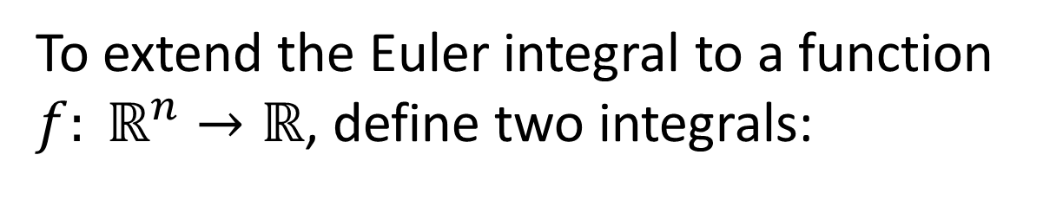
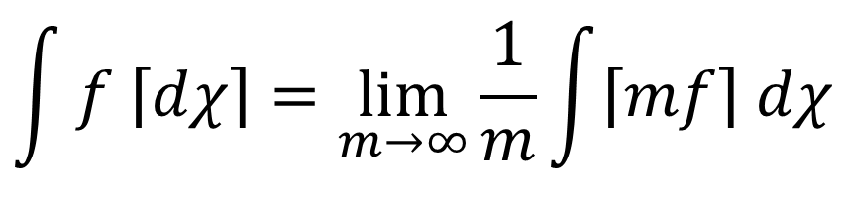
Continuous Functions
To extend the Euler integral to a function $f: ℝ^{n}→ℝ$, define two integrals:
$$\int{f \left\lfloor dχ\right\rfloor }=\lim_{m→∞}{\frac{1}{m}\int{\left\lfloor mf\right\rfloor dχ}}$$
Lower integral:
$$\int{f \left\lceil dχ\right\rceil }=\lim_{m→∞}{\frac{1}{m}\int{\left\lceil mf\right\rceil dχ}}$$
Upper integral:
These limits exist, but are not equal in general.

Slide 9
Application
Local
Data
Global
Data
Euler Integration is useful in sensor networks:
Networks of cell phones or computers
Traffic sensor networks
Surveillance and radar networks

Slide 10
How can we assign a notion of size to functions?
Lebesgue integral
Euler integral
Anything else?

Slide 11
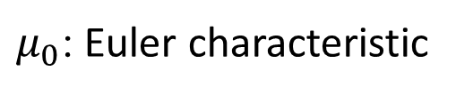


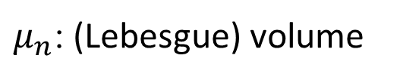
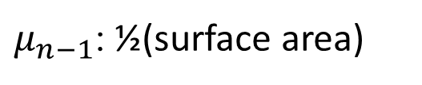
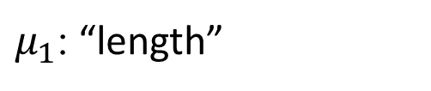
Intrinsic Volumes
The intrinsic volumes are the $n+1$ Euclidean-invariant valuations on subsets of $ℝ^{n}$, denoted $μ_{0},…,μ_{n}$.
$μ_{0}$: Euler characteristic
$μ_{n−1}$: ½(surface area)
1
0
$μ_{1}$: “length”
$μ_{n}$: (Lebesgue) volume
$$V=lwh$$

Slide 12
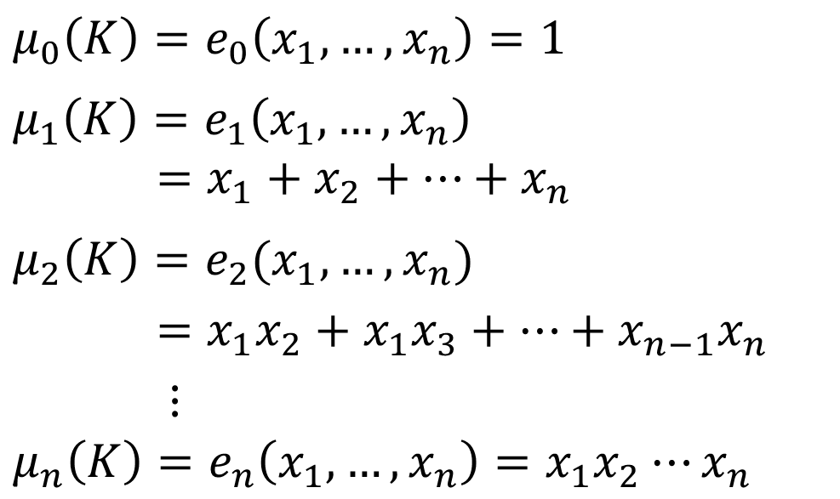
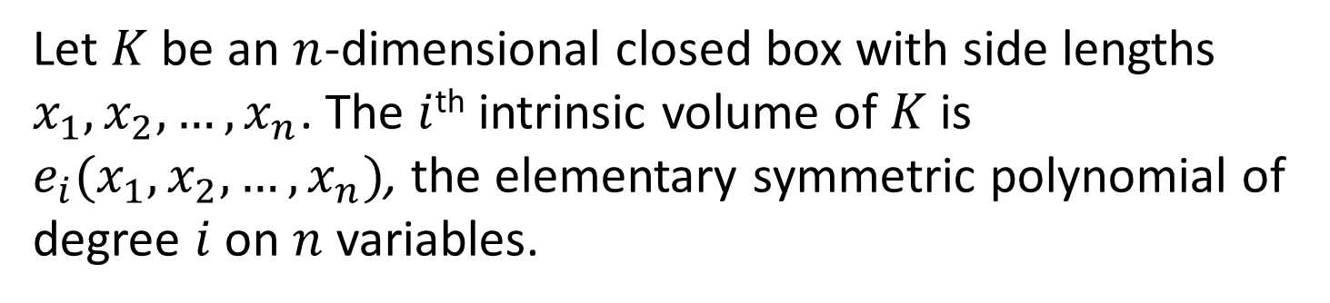



Example
Let $K$ be an $n$-dimensional closed box with side lengths $x_{1},x_{2},…, x_{n}$. The $i$^{th} intrinsic volume of $K$ is $e_{i}(x_{1},x_{2},…, x_{n})$, the elementary symmetric polynomial of degree $i$ on $n$ variables.
$$μ_{0}\left(K\right)=e_{0}\left(x_{1}, …, x_{n}\right)=1$$
$$μ_{1}\left(K\right)=e_{1}\left(x_{1}, …, x_{n}\right)$$
$=x_{1}+x_{2}+⋯+x_{n}$
$$μ_{2}\left(K\right)=e_{2}(x_{1},…,x_{n})$$
$=x_{1}x_{2}+x_{1}x_{3}+⋯+x_{n−1}x_{n}$
$⋮$
$$μ_{n}\left(K\right)=e_{n}\left(x_{1}, …,x_{n}\right)=x_{1}x_{2}⋯x_{n}$$
$$x_{3}$$
$$x_{2}$$
$$x_{1}$$

Slide 13
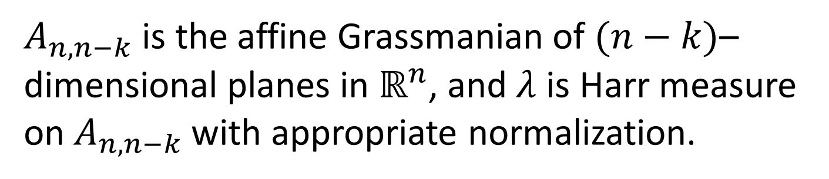

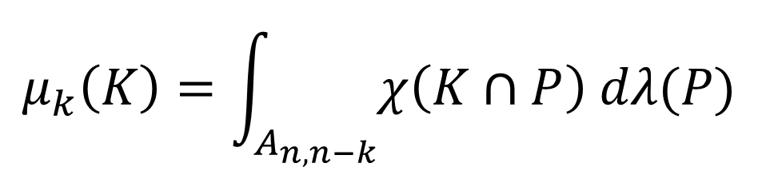
Intrinsic Volume Definition
For a “tame” set $K⊂ℝ$, the $k$^{th} intrinsic volume can be defined:
Hadwiger’s Formula
$$μ_{k}\left(K\right)=\int_{A_{n,n−k}}{χ\left(K∩P\right) dλ(P)}$$
$A_{n,n−k}$ is the affine Grassmanian of $(n−k)$–dimensional planes in $ℝ^{n}$, and $λ$ is Harr measure on $A_{n,n−k}$with appropriate normalization.

Slide 14


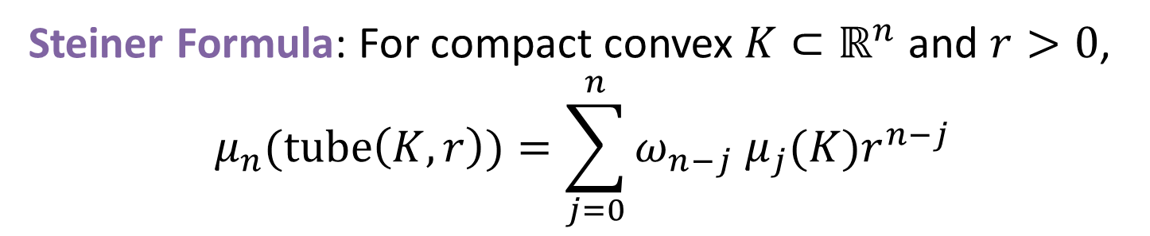
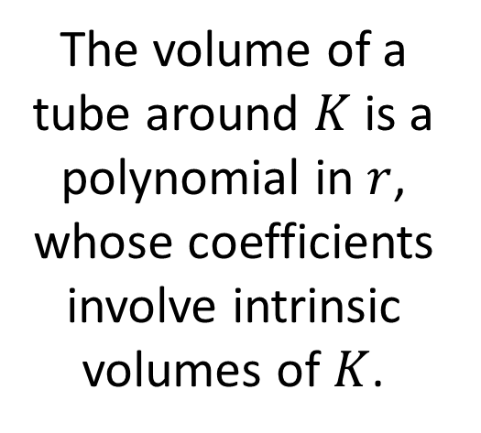


Tube Formula
$$tube(K,r)$$
The volume of a tube around $K$ is a polynomial in $r$, whose coefficients involve intrinsic volumes of $K$.
$$K$$
$$r$$
Steiner Formula: For compact convex $K⊂ℝ^{n}$ and $r>0$,
$$μ_{n}(tube\left(K,r\right))=\sum_{j=0}^{n}{ω_{n−j} μ_{j}(K)r^{n−j}}$$
volume of unit $(n−j)$-ball
intrinsic volume

Slide 15
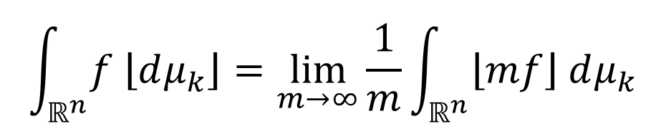
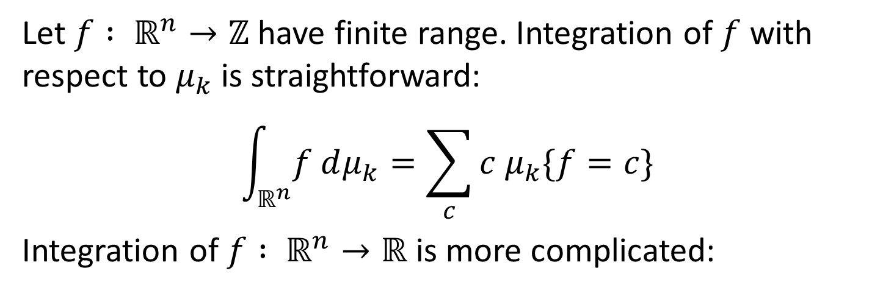
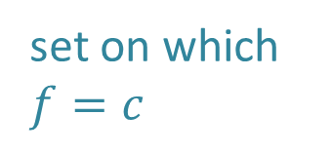
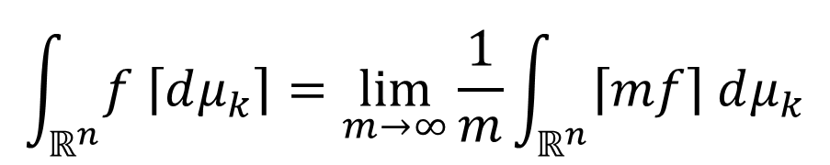
Hadwiger Integral
Let $f : ℝ^{n}→ℤ$ have finite range. Integration of $f$ with respect to $μ_{k}$ is straightforward:
$$\int_{ℝ^{n}}^{ }{f dμ_{k}}=\sum_{c}{c μ_{k}\{f=c\}}$$
Integration of $f : ℝ^{n}→ℝ$ is more complicated:
set on which $f=c$
$$\int_{ℝ^{n}}{f \left\lfloor dμ_{k}\right\rfloor }=\lim_{m→∞}{\frac{1}{m}\int_{ℝ^{n}}{\left\lfloor mf\right\rfloor dμ_{k}}}$$
Lower integral:
$$\int_{ℝ^{n}}{f \left\lceil dμ_{k}\right\rceil }=\lim_{m→∞}{\frac{1}{m}\int_{ℝ^{n}}{\left\lceil mf\right\rceil dμ_{k}}}$$
Upper integral:

Slide 16






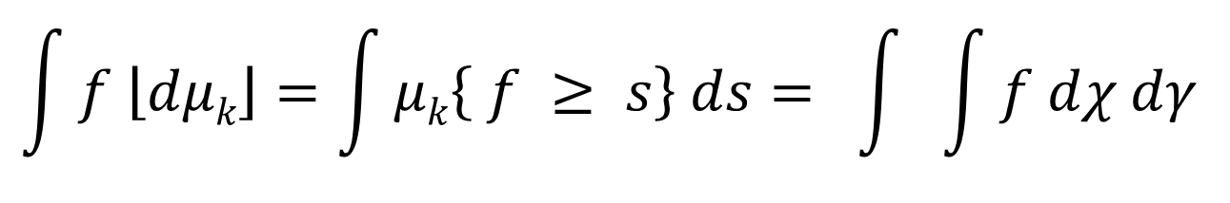
Hadwiger Integral
Let $X⊆ℝ^{n}$ be compact and $f :X→ℝ^{+}$ bounded.
$$\int{f \left\lfloor dμk\right\rfloor }=\int{μk\left\{ f ≥ s\right\} ds}= \int{ \int{f dχ dγ}}$$
∞
X
s = 0
$$A_{n,n−k}$$
$$P∩X$$
level sets
slices
ℝ
ℝ
$$f$$
$$f$$
$$ℝ^{n}$$
$$ℝ^{n}$$

Slide 17


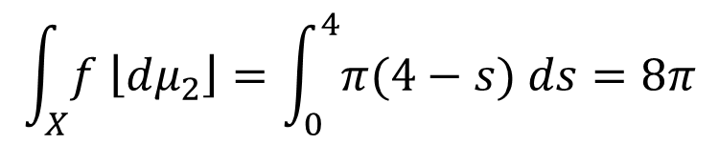

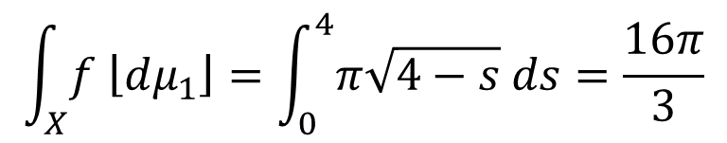
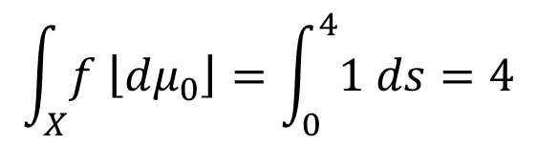


Example
Let $f\left(x,y\right)=4−x^{2}−y^{2}$ on $X=\left\{\left(x,y\right) | x^{2}−y^{2}≤4\right\}$.
Excursion set $\left\{f≥s\right\}$ is a circle of radius $\sqrt{4−s}$.
ℝ
$$f$$
Hadwiger Integrals:
$$\int_{X}^{ }{f \left\lfloor dμ_{0}\right\rfloor }=\int_{0}^{4}{1 ds}=4$$
$$s$$
$$\int_{X}^{ }{f \left\lfloor dμ_{1}\right\rfloor }=\int_{0}^{4}{π\sqrt{4−s} ds}=\frac{16π}{3}$$
$$X$$
$$ℝ^{2}$$
$$\int_{X}^{ }{f \left\lfloor dμ_{2}\right\rfloor }=\int_{0}^{4}{π(4−s) ds}=8π$$

Slide 18
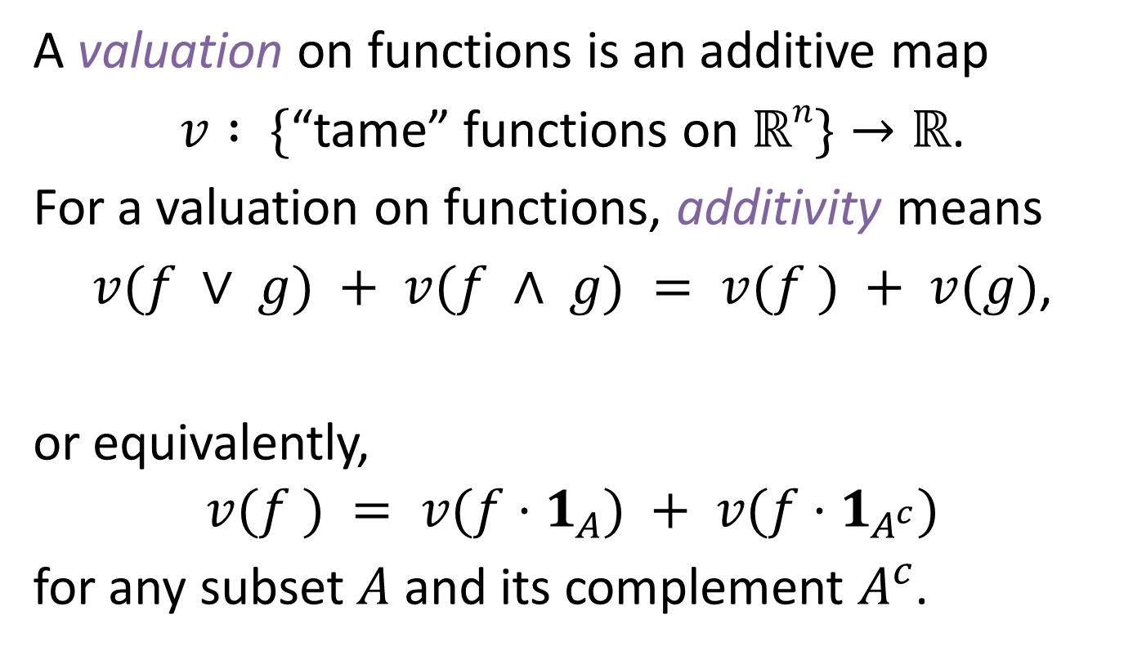
Valuations on Functions
A valuation on functions is an additive map
$v : \{$“tame” functions on $ℝn\}→ℝ$.
For a valuation on functions, additivity means
$v(f ∨ g) + v(f ∧ g) = v(f ) + v(g)$,
or equivalently,
$$v(f ) = v(f⋅1_{A}) + v(f⋅1_{A^{c}})$$
for any subset $A$ and its complement $A^{c}$.
pointwise max
pointwise min

Slide 19
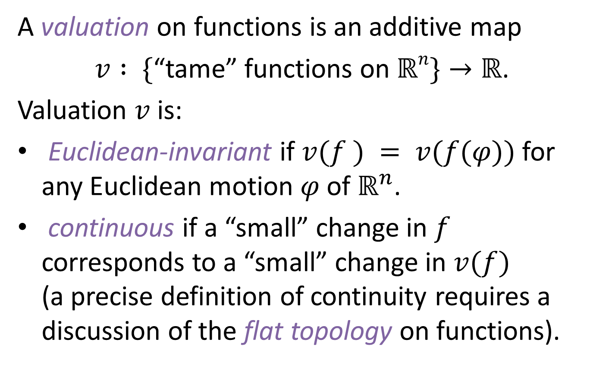
Valuations on Functions
A valuation on functions is an additive map
$v : \{$“tame” functions on $ℝn\}→ℝ$.
Valuation $v$ is:
Euclidean-invariant if $v(f ) = v(f(φ))$ for any Euclidean motion $φ$ of $ℝ^{n}$.
continuous if a “small” change in $f$ corresponds to a “small” change in $v(f)$
(a precise definition of continuity requires a discussion of the flat topology on functions).

Slide 20
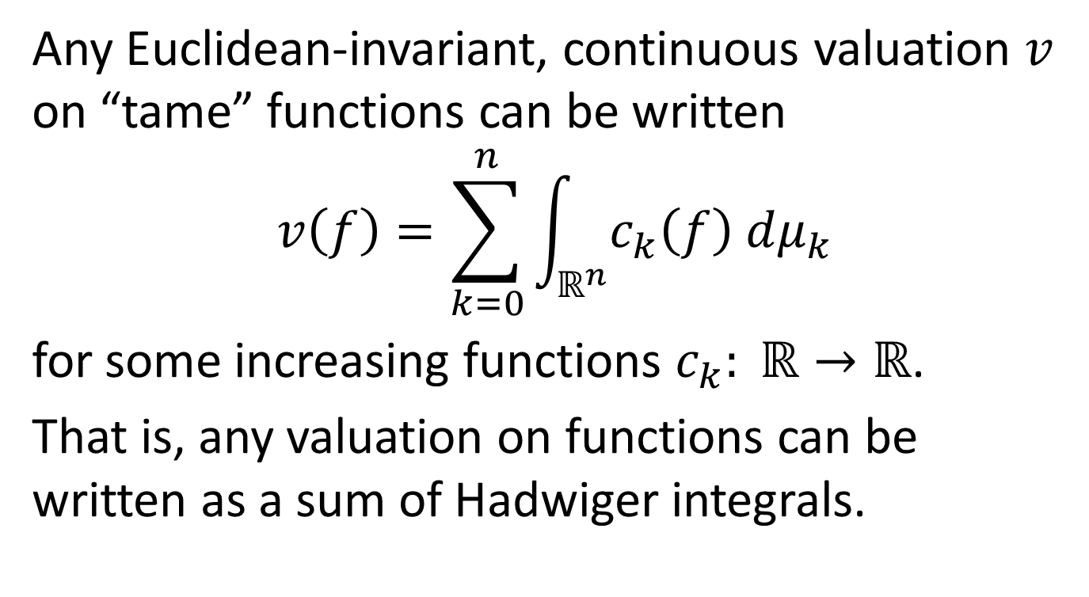
Hadwiger’s Theorem for Functions
(Baryshnikov, Ghrist, Wright)
Any Euclidean-invariant, continuous valuation $v$ on “tame” functions can be written
$$v\left(f\right)=\sum_{k=0}^{n}{\int_{ℝ^{n}}^{ }{c_{k}\left(f\right) dμ_{k}}}$$
for some increasing functions $c_{k}: ℝ→ℝ$.
That is, any valuation on functions can be written as a sum of Hadwiger integrals.

Slide 21
How can we assign a notion of size to functions?
Lebesgue integral
Euler integral
Hadwiger Integral
Any valuation on functions can be written in terms of Hadwiger integrals.

Slide 22
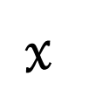


$$2$$
$$1$$
Applications and Challenges
$$x$$

Slide 23

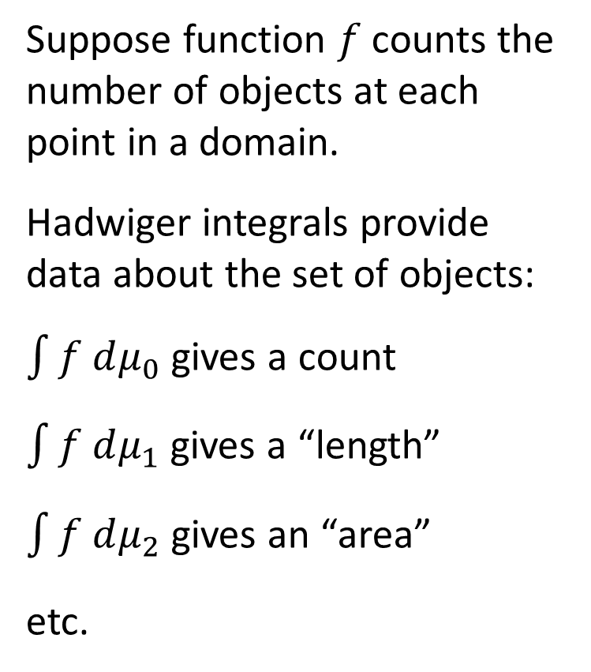
Surveillance
$$f$$
Suppose function $f$ counts the number of objects at each point in a domain.
Hadwiger integrals provide data about the set of objects:
$\int{f dμ_{0}}$ gives a count
$\int{f dμ_{1}}$ gives a “length”
$\int{f dμ_{2}}$ gives an “area”
etc.
1
3
2
0
2
0
0
2
1
1
1
3
2
2
3
1
2
1
0

Slide 24

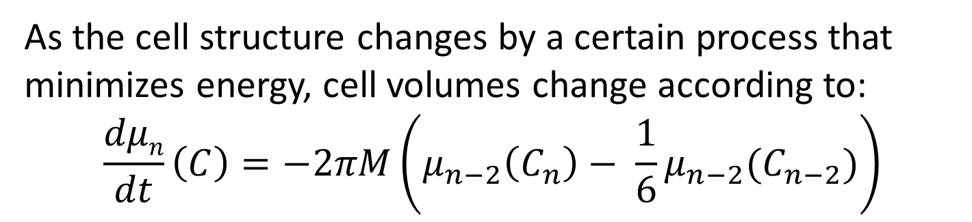
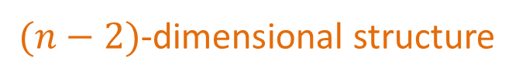
Cell Dynamics
As the cell structure changes by a certain process that minimizes energy, cell volumes change according to:
$$\frac{dμn}{dt}\left(C\right)=−2πM\left(μ_{n−2}\left(C_{n}\right)− \frac{1}{6}μ_{n−2}(C_{n−2})\right)$$
$n$-dimensional structure
$(n−2)$-dimensional structure

Slide 25
Image Processing
Intrinsic volumes are of utility in image processing.
A greyscale image can be viewed as a real-valued function on a planar domain.
With such a perspective, Hadwiger integrals may be useful to return information about an image.
Applications may also include color or hyperspectral images, or images on higher-dimensional domains.
K. Schladitz, J. Ohser, and W. Nagel. “Measuring Intrinsic Volumes in Digital 3d Images.” Discrete Geometry for Computer Images. Springer, 2006.

Slide 26

Percolation
Question: Can liquid flow through a porous material from top to bottom?
Functional approach: Define a permeability function in a solid material.
Hadwiger integrals may be useful in such a functional approach to percolation theory.
$$ℝ^{3}$$

Slide 27



Surveillance
Let $f:T→ℤ$ count objects locally in a domain ${T⊆ℝ}^{2}$.
$$f$$
Then the Euler integral gives the global count:
1
3
2
0
2
$\int_{T}^{ }{f dμ_{0}}=5$
0
0
2
?
1
What if part of $T$ is not observable?
1
1
3
?
?
2
2
3
Idea: Model the function with a random field. Estimate the global count via the expected Euler integral.
1
2
1
0

Slide 28
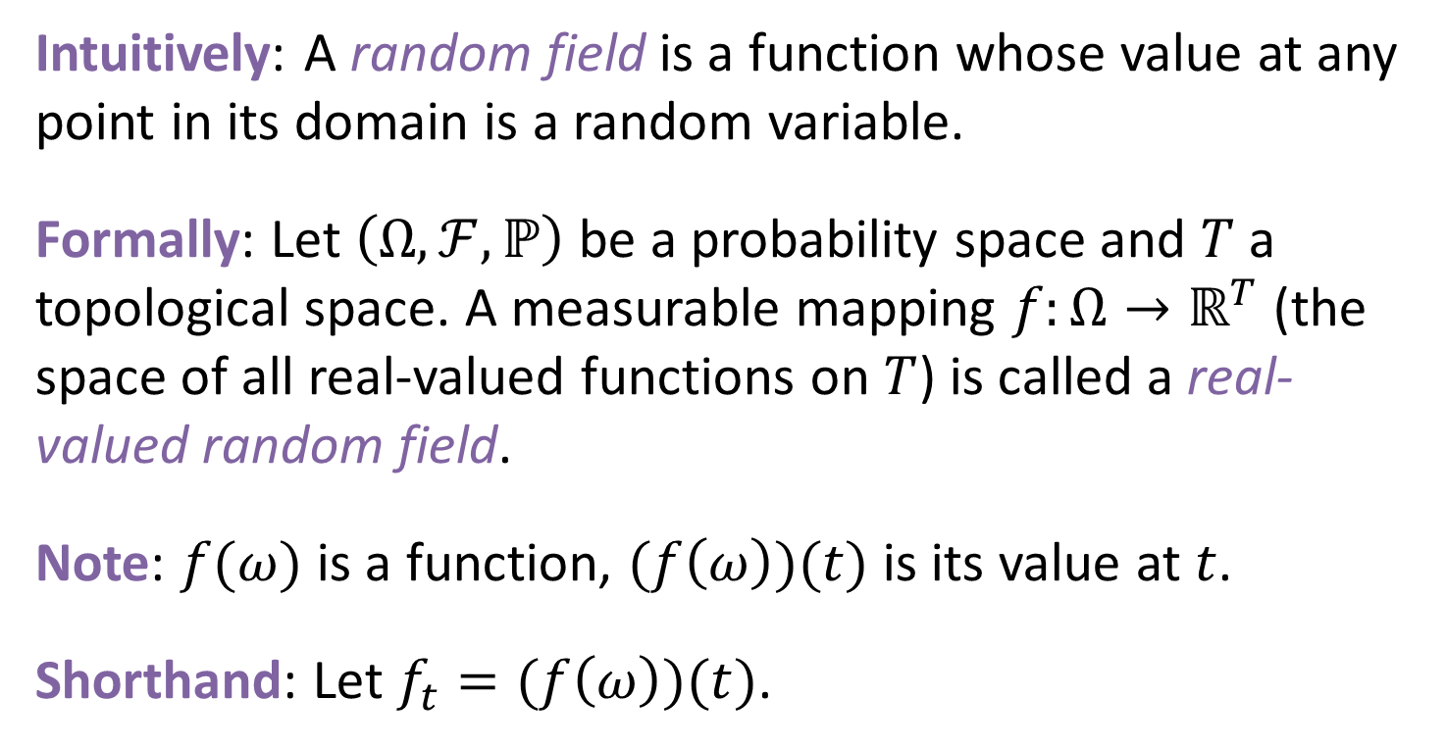
Random Field
Intuitively: A random field is a function whose value at any point in its domain is a random variable.
Formally: Let $\left(Ω,ℱ, ℙ\right)$ be a probability space and $T$ a topological space. A measurable mapping $f:Ω→ℝ^{T}$ (the space of all real-valued functions on $T$) is called a real-valued random field.
Note: $f(ω)$ is a function, $(f\left(ω\right))(t)$ is its value at $t$.
Shorthand: Let $f_{t}=(f\left(ω\right))(t)$.

Slide 29
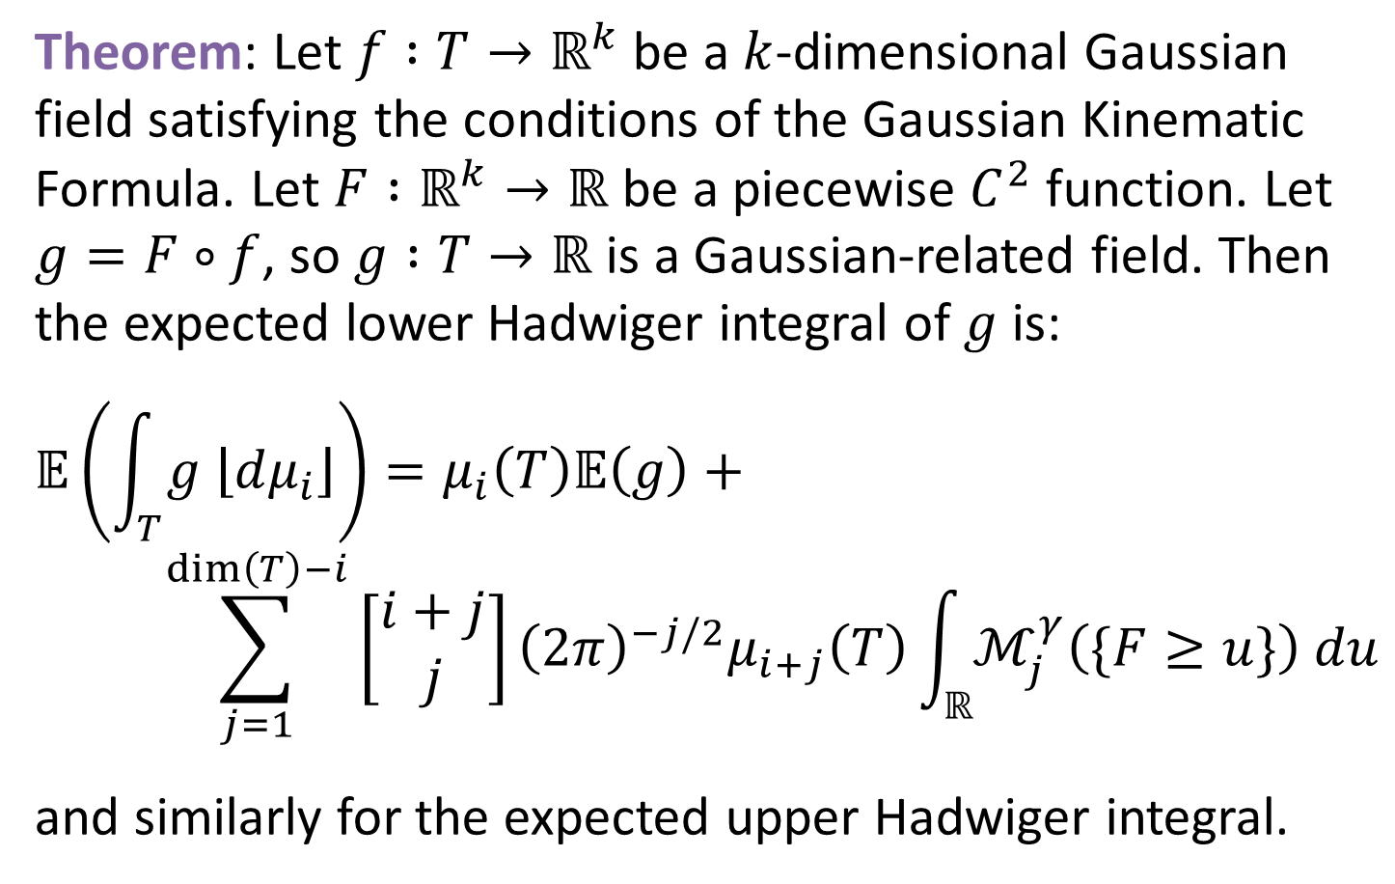
Expected Hadwiger Integral
Theorem: Let $f :T→ℝ^{k}$ be a $k$-dimensional Gaussian field satisfying the conditions of the Gaussian Kinematic Formula. Let $F :ℝ^{k}→ℝ$ be a piecewise $C^{2}$ function. Let $g=F∘f$, so $g :T→ℝ$ is a Gaussian-related field. Then the expected lower Hadwiger integral of $g$ is:
$$𝔼\left(\int_{T}^{ }{g \left\lfloor dμ_{i}\right\rfloor }\right)=μ_{i}\left(T\right)𝔼\left(g\right)+$$
$$\sum_{j=1}^{dim\left(T\right)−i}{\left[\begin{matrix}i+j \\ j\end{matrix}\right]{\left(2π\right)}^{−j/2}μ_{i+j}\left(T\right)\int_{ℝ}^{ }{ℳ_{j}^{γ}\left(\{F≥u\}\right) du}}$$
and similarly for the expected upper Hadwiger integral.

Slide 30
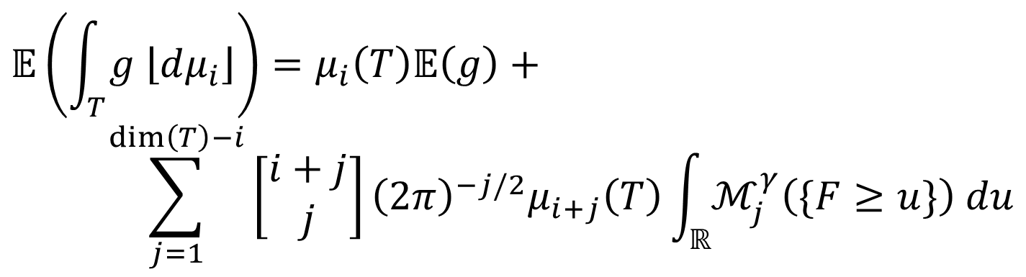
Computational Difficulties
Computing expected Hadwiger integrals of random fields is difficult in general.
$$𝔼\left(\int_{T}^{ }{g \left\lfloor dμ_{i}\right\rfloor }\right)=μ_{i}\left(T\right)𝔼\left(g\right)+$$
$$\sum_{j=1}^{dim\left(T\right)−i}{\left[\begin{matrix}i+j \\ j\end{matrix}\right]{\left(2π\right)}^{−j/2}μ_{i+j}\left(T\right)\int_{ℝ}^{ }{ℳ_{j}^{γ}\left(\{F≥u\}\right) du}}$$
intrinsic volumes: tricky, but possible to compute
Gaussian Minkowski functionals: very difficult to compute, except in special cases

Slide 31

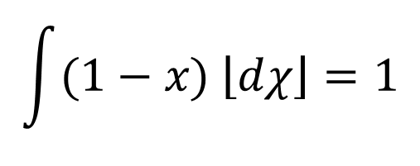

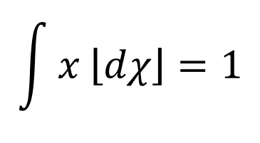




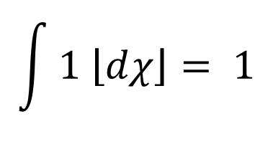

Challenge: Non-Linearity
Consider the following Euler integrals:
$$y=1$$
$$1$$
$$1$$
$$1$$
$$y=x$$
$$y=1−x$$
$$x$$
$$x$$
$$x$$
$$\int{x \left\lfloor dχ\right\rfloor }=1$$
$$\int{(1−x) \left\lfloor dχ\right\rfloor }=1$$
$$\int{1 \left\lfloor dχ\right\rfloor }= 1$$
[0, 1]
[0, 1]
[0, 1]
Upper and lower Hadwiger integrals are not linear in general.

Slide 32

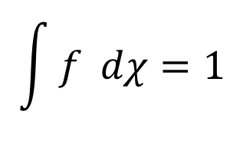

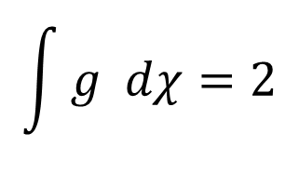







Challenge: Continuity
A change in a function $f$ on a small set (in the Lebesgue) sense can result in a large change in the Hadwiger integrals of $f$.
$$2$$
$$2$$
Similar examples exist for higher-dimensional Hadwiger integrals.
$$f$$
$$g$$
$$1$$
$$1$$
$$x$$
$$x$$
$$\int{f dχ}=1$$
$$\int{g dχ}=2$$
Working with Hadwiger integrals requires different intuition than working with Lebesgue integrals.

Slide 33
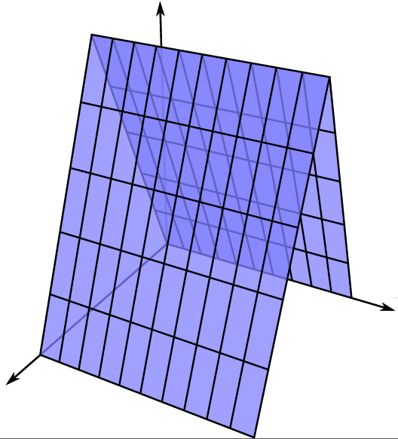
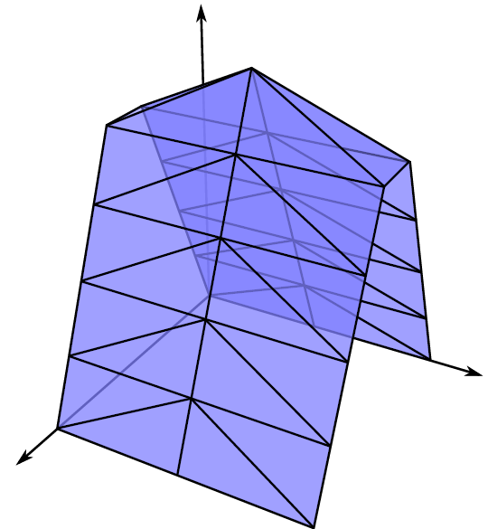
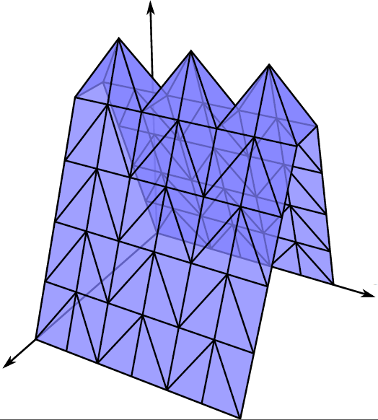
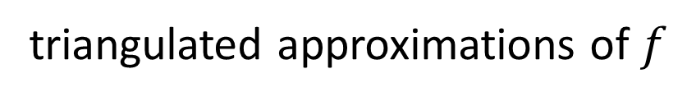


Challenge: Approximations
How can we approximate the Hadwiger integrals of a function sampled at discrete points?
$$f:{\left[0,1\right]}^{2}→ℝ$$
triangulated approximations of $f$
Hadwiger integrals of interpolations of $f$ might diverge, even when the approximations converge pointwise to $f$.

Slide 34
Summary
The intrinsic volumes provide notions of size for sets, generalizing both Euler characteristic and Lebesgue measure.
Analogously, the Hadwiger integrals provide notions of size for real-valued functions.
Hadwiger integrals are useful in applications such as surveillance, sensor networks, cell dynamics, and image processing.
Hadwiger integrals bring theoretical and computational challenges, and provide many open questions for future study.

Slide 35
References
Yuliy Baryshnikov and Robert Ghrist. “Target Enumeration via Euler Characteristic Integration.” SIAM J. Appl. Math. 70(3), 2009, 825–844.
Yuliy Baryshnikov and Robert Ghrist. “Definable Euler integration.” Proc. Nat. Acad. Sci. 107(21), 2010, 9525-9530.
Yuliy Baryshnikov, Robert Ghrist, and Matthew Wright. “Hadwiger’s Theorem for Definable Functions.” Advances in Mathematics. Vol. 245 (2013) p. 573-586.
Omer Bobrowski and Matthew Strom Borman. “Euler Integration of Gaussian Random Fields and Persistent Homology.” Journal of Topology and Analysis, 4(1), 2012.
S. H. Shanuel. “What is the Length of a Potato?” Lecture Notes in Mathematics. Springer, 1986, 118 – 126.
Matthew Wright. “Hadwiger Integration of Definable Functions.” Publicly accessible Penn Dissertations. Paper 391. http://repository.upenn.edu/edissertations/391.

