Slide 1
Hadwiger Integration and Applications
Matthew Wright
Institute for Mathematics and its Applications
University of Minnesota
November 22, 2013

Slide 2

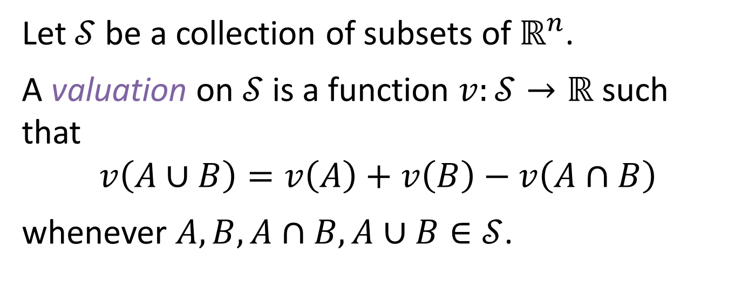



A valuation is a notion of size.
Let $𝒮$ be a collection of subsets of $ℝ^{n}$.
A valuation on $𝒮$is a function $v:𝒮→ℝ$ such that
$$v\left(A∪B\right)=v\left(A\right)+v\left(B\right)−v\left(A∩B\right)$$
whenever $A, B,A∩B, A∪B∈𝒮$.
additive property
$$A$$
$$A∪B$$
$$B$$
$$A∩B$$

Slide 3







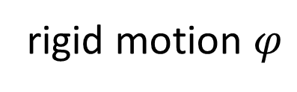



Valuation $v$ is Euclidean-invariant if $v(A)$ is unchanged by rigid motions of $A$.
rigid motion $φ$
$$A$$
$$φ\left(A\right)$$
$$v\left(A\right)=v(φ\left(A\right))$$
Valuation $v$ is continuous if a small change in $A$ results in a small change in $v(A)$.
$$A≈B$$
$$A$$
$$B$$
$$⇓$$
$$v\left(A\right)≈v\left(B\right)$$

Slide 4
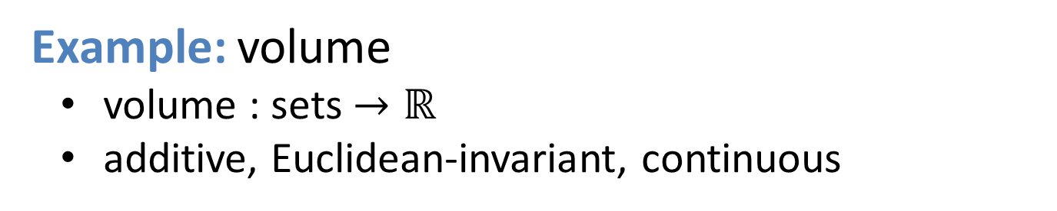
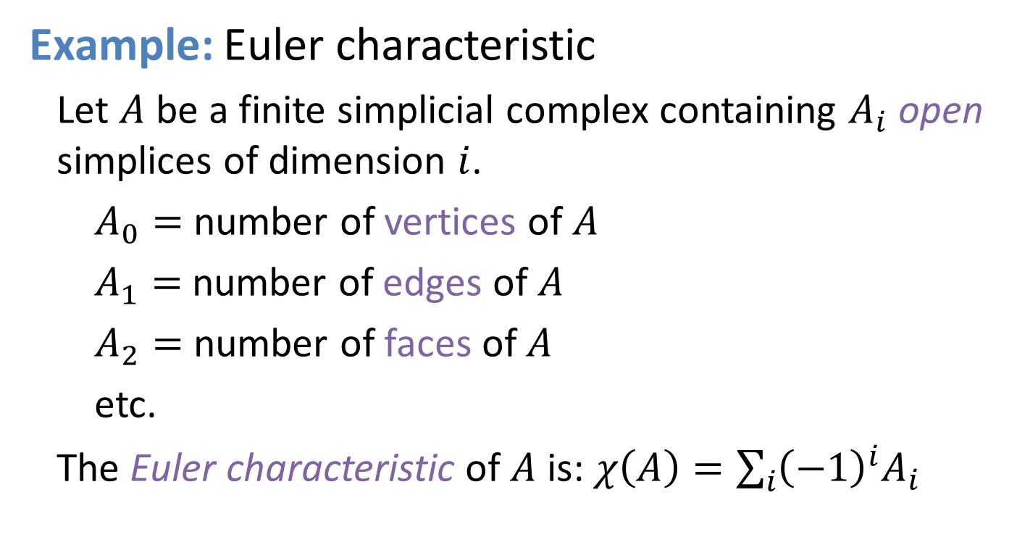
Example: volume
volume : sets $→ℝ$
additive, Euclidean-invariant, continuous
Example: Euler characteristic
Let $A$ be a finite simplicial complex containing $A_{i}$ open simplices of dimension $i$.
$A_{0}=$ number of vertices of $A$
$A_{1}=$ number of edges of $A$
$A_{2}=$ number of faces of $A$
etc.
The Euler characteristic of $A$ is: $χ\left(A\right)=\sum_{i}{{\left(−1\right)}^{i}A_{i}}$
v
combinatorial

Slide 5
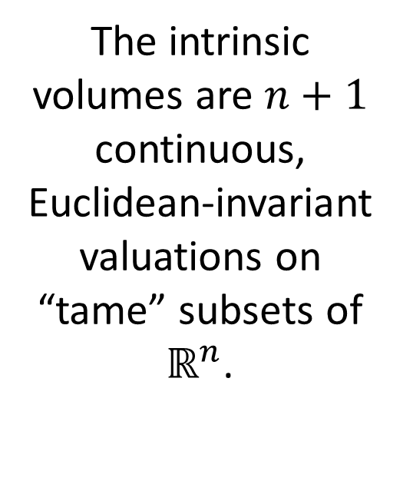
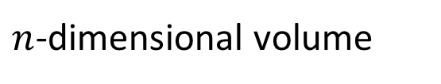

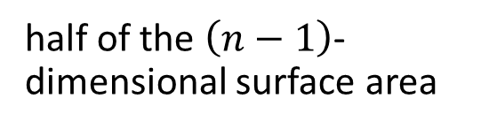
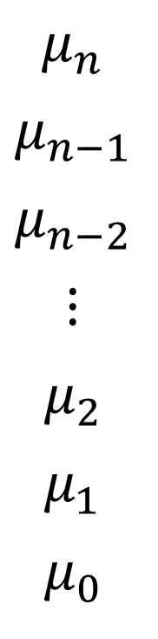
The intrinsic volumes generalize both volume and Euler characteristic.
$μ_{n}$
$μ_{n−1}$
$μ_{n−2}$
$⋮$
$μ_{2}$
$μ_{1}$
$μ_{0}$
$n$-dimensional volume
The intrinsic volumes are $n+1$ continuous, Euclidean-invariant valuations on “tame” subsets of $ℝ^{n}$.
half of the $\left(n−1\right)$-dimensional surface area
$μ_{k}$ gives a $k$-dimensional notion of size
“mean width”
Euler characteristic

Slide 6
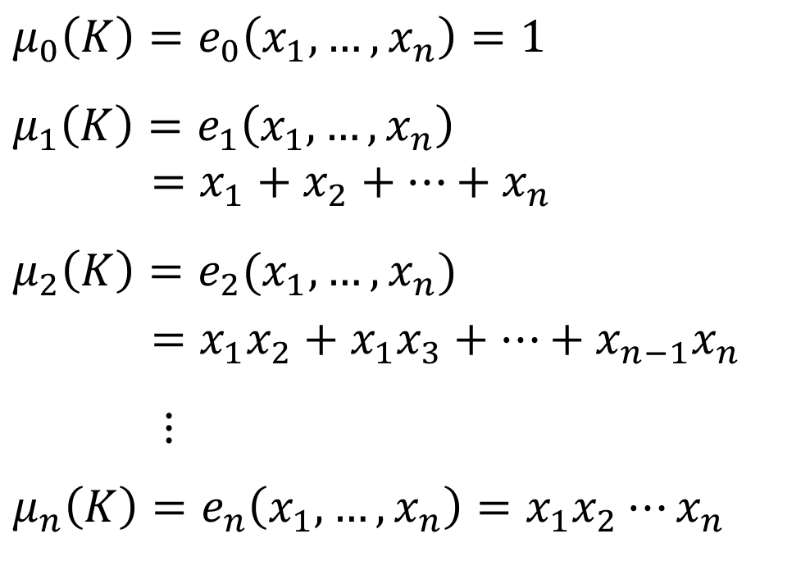
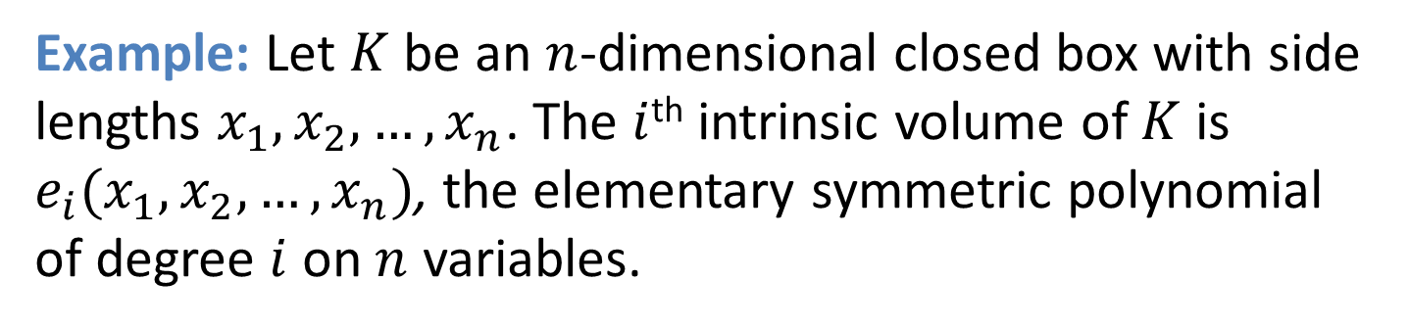



Example: Let $K$ be an $n$-dimensional closed box with side lengths $x_{1},x_{2},…, x_{n}$. The $i$^{th} intrinsic volume of $K$ is $e_{i}(x_{1},x_{2},…, x_{n})$, the elementary symmetric polynomial of degree $i$ on $n$ variables.
$$μ_{0}\left(K\right)=e_{0}\left(x_{1}, …, x_{n}\right)=1$$
$$μ_{1}\left(K\right)=e_{1}\left(x_{1}, …, x_{n}\right)$$
$=x_{1}+x_{2}+⋯+x_{n}$
$$μ_{2}\left(K\right)=e_{2}(x_{1},…,x_{n})$$
$=x_{1}x_{2}+x_{1}x_{3}+⋯+x_{n−1}x_{n}$
$⋮$
$$μ_{n}\left(K\right)=e_{n}\left(x_{1}, …,x_{n}\right)=x_{1}x_{2}⋯x_{n}$$
$$x_{3}$$
$$x_{2}$$
$$x_{1}$$

Slide 7

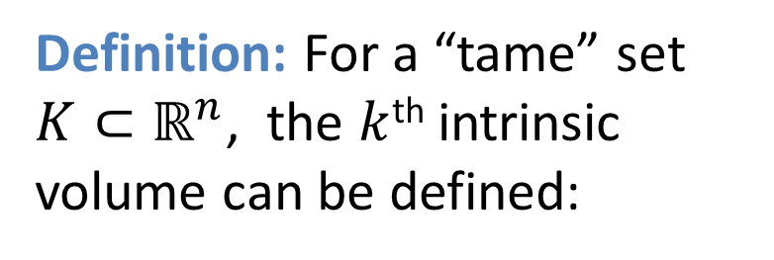



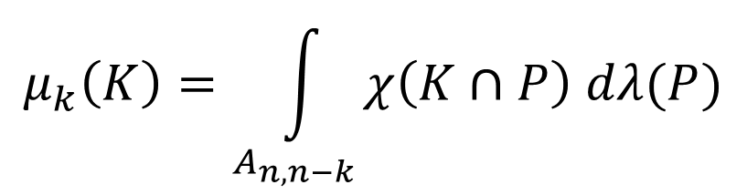
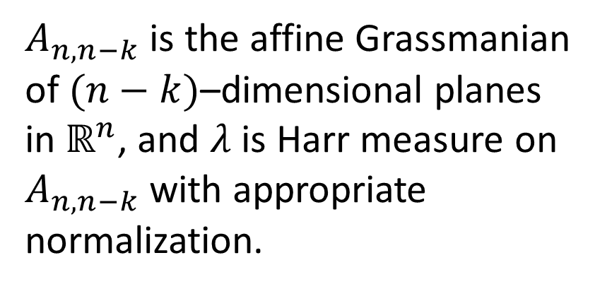
Definition: For a “tame” set $K⊂ℝ^{n}$, the $k$^{th} intrinsic volume can be defined:
$$P$$
Hadwiger’s Formula
$$μ_{k}\left(K\right)=\int_{A_{n,n−k}}^{ }{χ\left(K∩P\right) dλ(P)}$$
$$K$$
$A_{n,n−k}$ is the affine Grassmanian of $(n−k)$–dimensional planes in $ℝ^{n}$, and $λ$ is Harr measure on $A_{n,n−k}$with appropriate normalization.
$$χ\left(K∩P\right)=1$$
$$χ\left(K∩P\right)=2$$

Slide 8













$$tube(K,r)$$
Let $K⊂ℝ^{2}$ be compact and convex.
$$K$$
What is the area of a tube of radius $r$ around $K$?
$$r$$
perimeter of $K$
Euler charac-teristic of $K$
area of tube
area of $K$
$$μ_{2}\left(\text{tube}\left(K,r\right)\right)=$$
$$μ_{2}\left(K\right)+$$
$$2μ_{1}\left(K\right) r+$$
$$πμ_{0}\left(K\right) r^{2}$$
The area of tube around $K⊂ℝ^{2}$ is a polynomial in $r$ whose coefficients involve the intrinsic volumes of $K$.

Slide 9

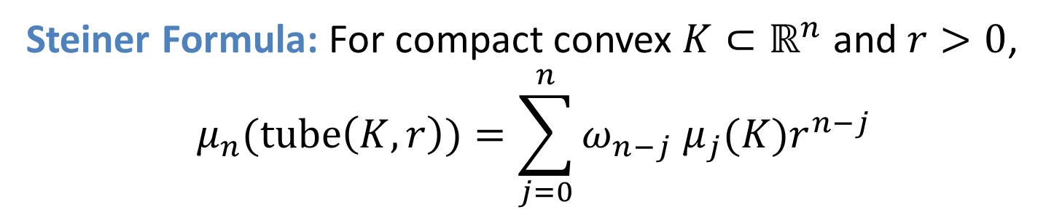


$$tube(K,r)$$
In general: the volume of a tube around $K⊂ℝ^{n}$ is a polynomial in $r$, whose coefficients involve intrinsic volumes of $K$.
$$K$$
$$r$$
Steiner Formula: For compact convex $K⊂ℝ^{n}$ and $r>0$,
$$μ_{n}(tube\left(K,r\right))=\sum_{j=0}^{n}{ω_{n−j} μ_{j}(K)r^{n−j}}$$
volume of unit $(n−j)$-ball
intrinsic volume

Slide 10
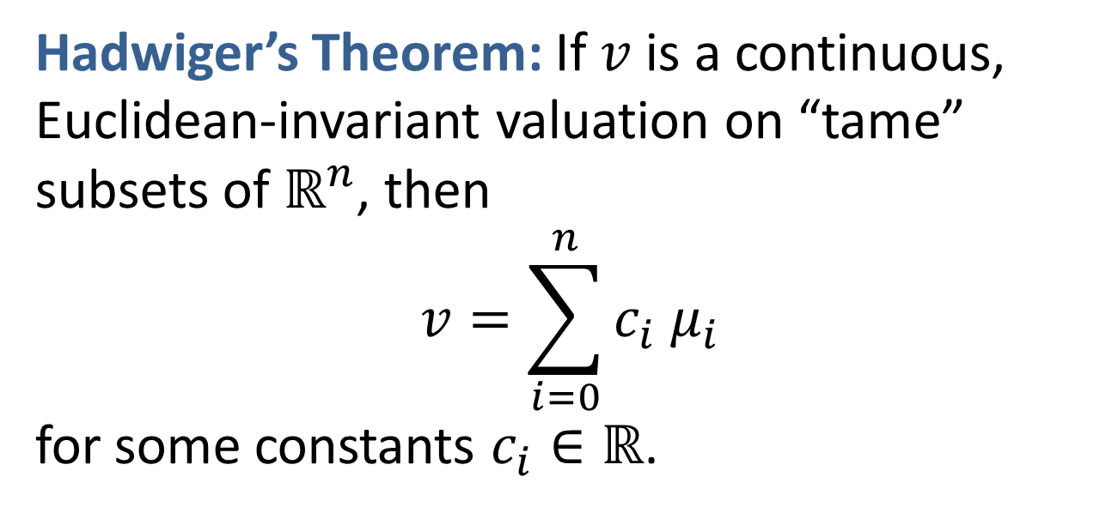
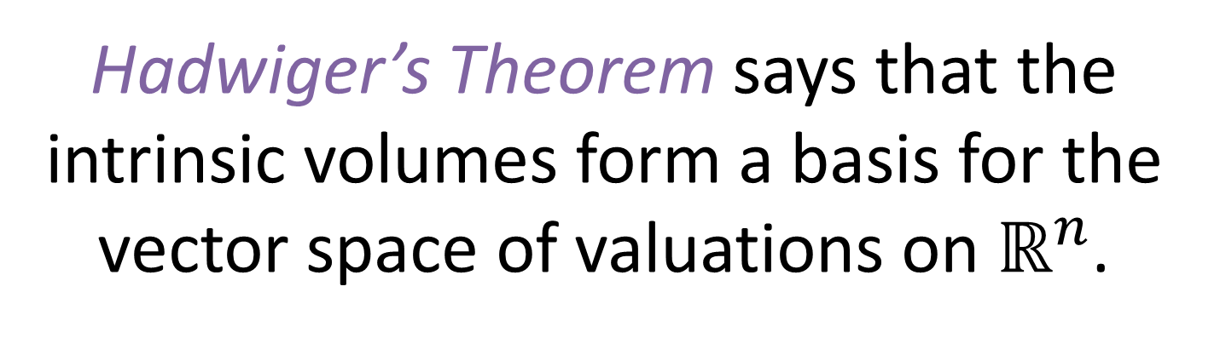
Hadwiger’s Theorem says that the intrinsic volumes form a basis for the vector space of valuations on $ℝ^{n}$.
Hadwiger’s Theorem: If $v$ is a continuous, Euclidean-invariant valuation on “tame” subsets of $ℝ^{n}$, then
$$v=\sum_{i=0}^{n}{c_{i}{ μ}_{i}}$$
for some constants $c_{i}∈ℝ$.

Slide 11
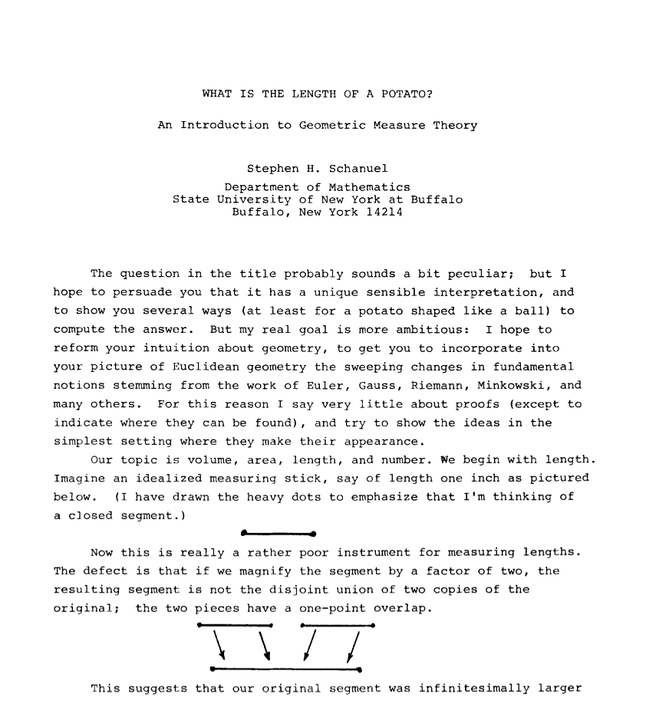
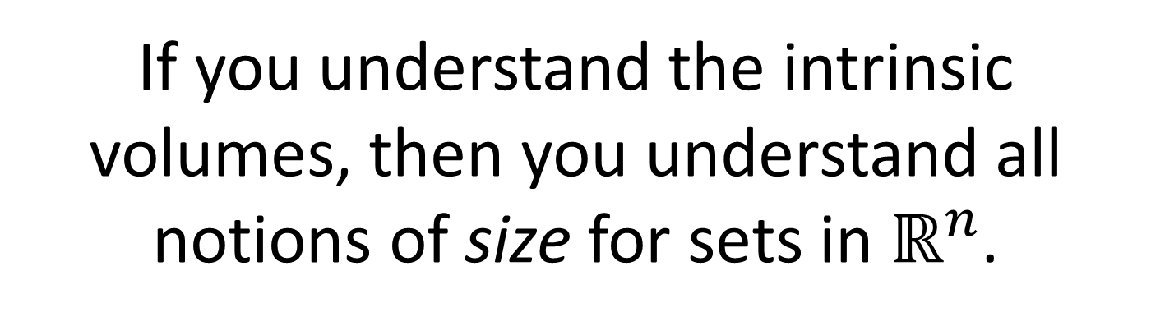
If you understand the intrinsic volumes, then you understand all notions of size for sets in $ℝ^{n}$.
WHAT IS THE LENGTH OF A POTATO?

Slide 12
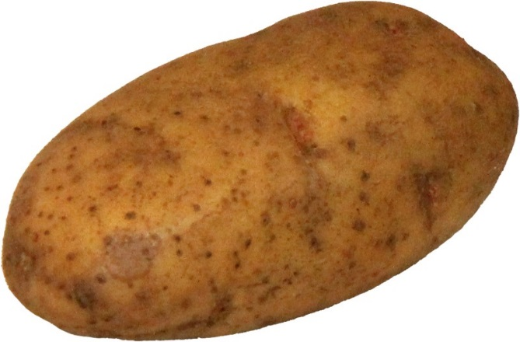
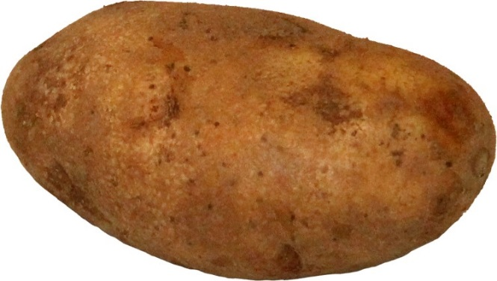
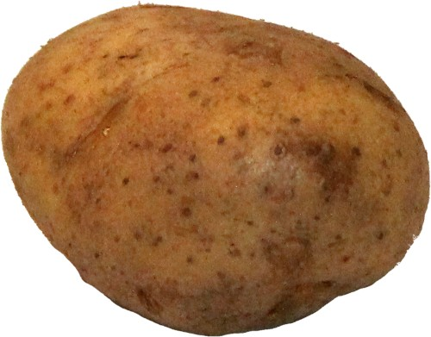
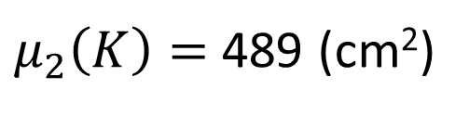
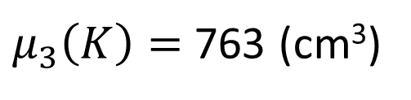

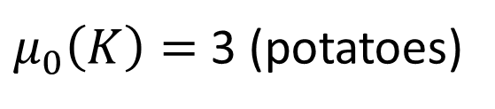
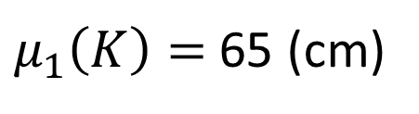
Example: How big is this set?
$$K⊂ℝ^{3}$$
volume:
$μ_{3}\left(K\right)=$ 763 (cm³)
area:
$μ_{2}\left(K\right)=$ 489 (cm²)
or any linear combination of these
length:
$μ_{1}\left(K\right)=$ 65 (cm)
number:
$μ_{0}\left(K\right)=$ 3 (potatoes)

Slide 13

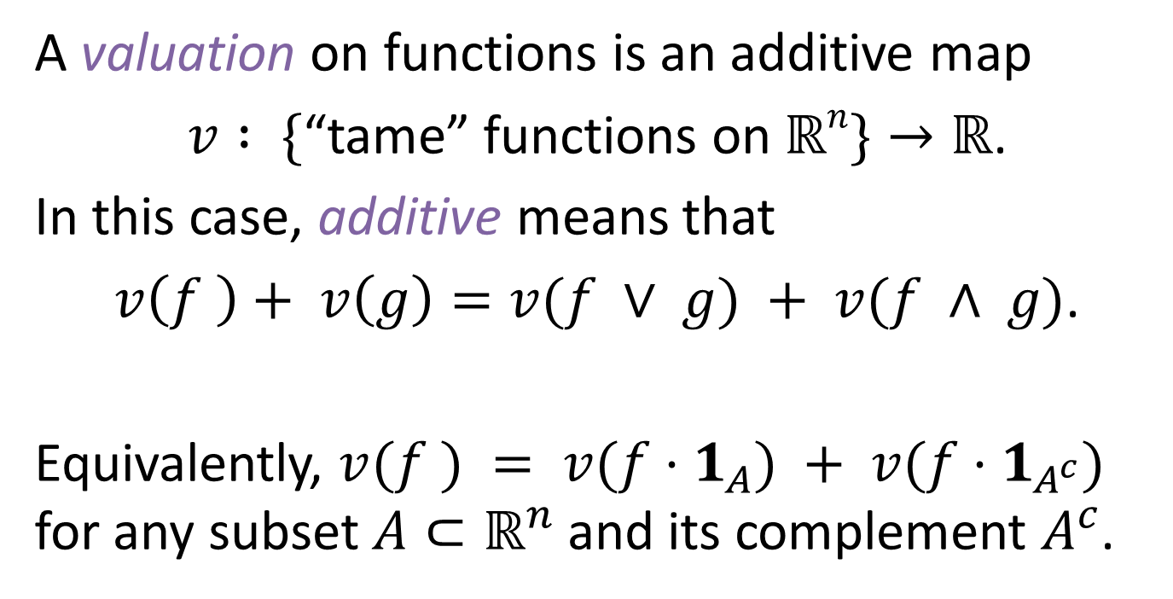
What valuations exist on functions on $ℝ^{n}$?
A valuation on functions is an additive map
$v : \{$“tame” functions on $ℝn\}→ℝ$.
In this case, additive means that
$v\left(f \right)+ v\left(g\right)=v(f ∨ g) + v(f ∧ g)$.
Equivalently, $v(f ) = v(f⋅1_{A}) + v(f⋅1_{A^{c}})$ for any subset $A⊂ℝ^{n}$ and its complement $A^{c}$.
pointwise max
pointwise min

Slide 14

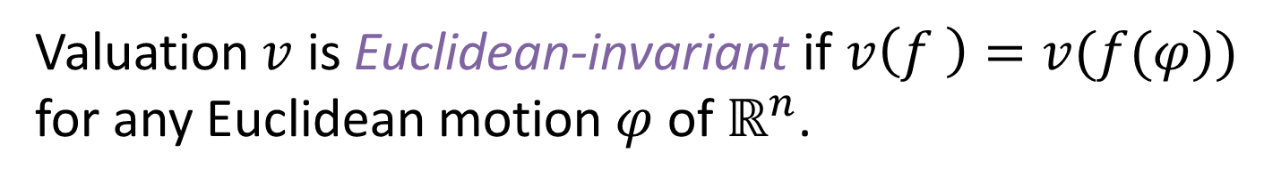

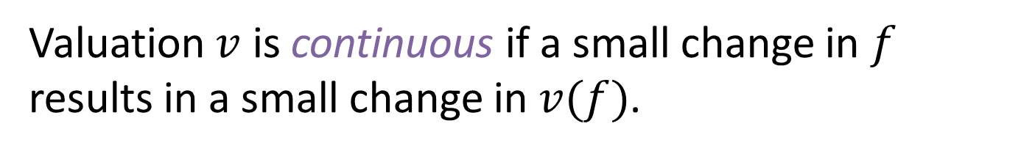






Valuation $v$ is Euclidean-invariant if $v\left(f \right)=v(f(φ))$ for any Euclidean motion $φ$ of $ℝ^{n}$.
$$f$$
$$f\left(φ\right)$$
$$φ$$
$$v\left(f\right)=v(f\left(φ\right))$$
Valuation $v$ is continuous if a small change in $f$ results in a small change in $v(f)$.
$$f$$
$$g$$
$$f≈g$$
$$⇓$$
$$v\left(f\right)≈v\left(g\right)$$

Slide 15




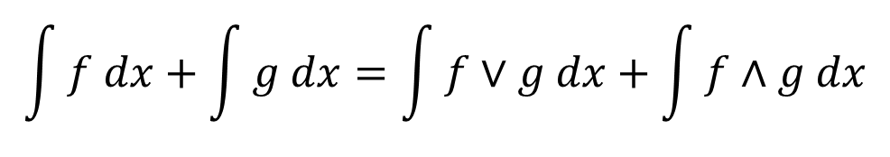
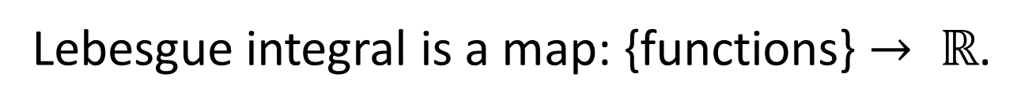
Example: Lebesgue integral
Lebesgue integral is a map: {functions} $→ ℝ$.
$$f$$
$$g$$
$$f∨g$$
$$f∧g$$
Lebesgue integral is:
$$\int{f dx}+\int{g dx}=\int{f∨g dx}+\int{f∧g dx}$$
Additive
Euclidean-invariant
Continuous

Slide 16
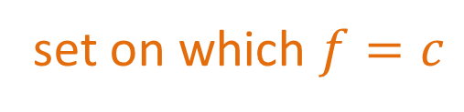
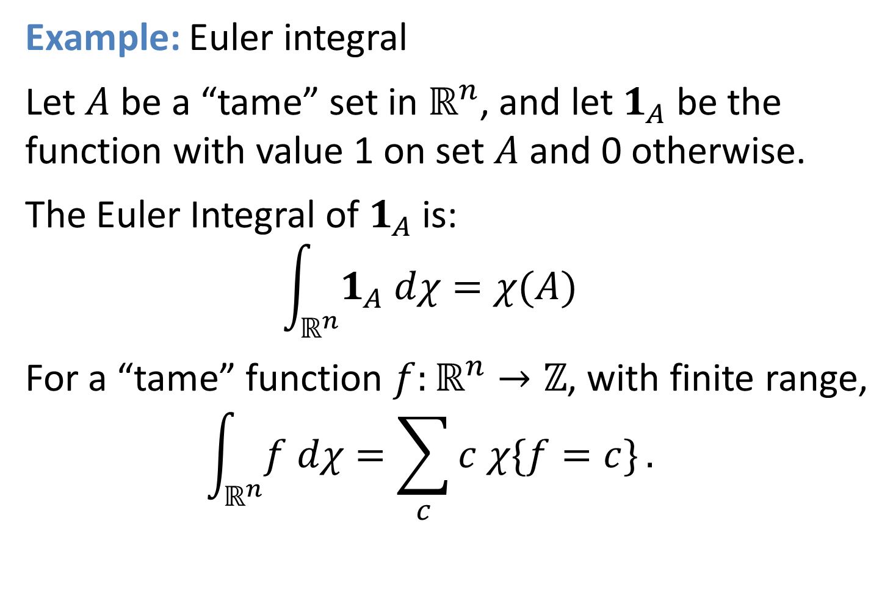
Example: Euler integral
Let $A$ be a “tame” set in $ℝ^{n}$, and let $1_{A}$ be the function with value 1 on set $A$ and 0 otherwise.
The Euler Integral of $1_{A}$ is:
$$\int_{ℝ^{n}}^{ }{1_{A} dχ}=χ(A)$$
For a “tame” function $f:ℝ^{n}→ℤ$, with finite range,
$$\int_{ℝ^{n}}^{ }{f dχ}=\sum_{c}^{ }{c χ\{f=c\}}.$$
set on which $f=c$

Slide 17

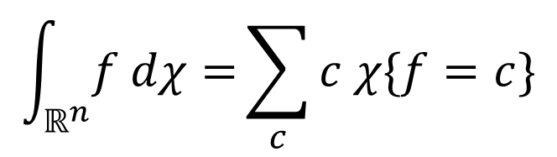







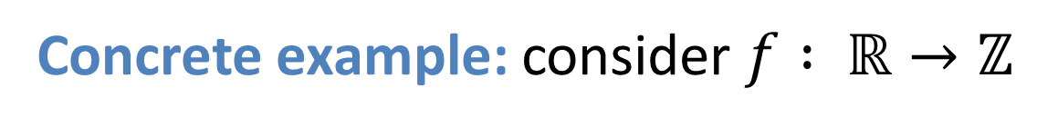


Concrete example: consider $f : ℝ→ℤ$
$$\int_{ℝ^{n}}^{ }{f dχ=}\sum_{c}^{ }{c χ\{f=c\}}$$
3
$$f(x)$$
$$=1⋅0$$
$$←c=1$$
2
$+ 2⋅(−1)$
$$←c=2$$
$$+ 3⋅2$$
$$←c=3$$
1
$$=4$$
$$x$$
Euler integral of $f$

Slide 18


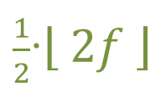

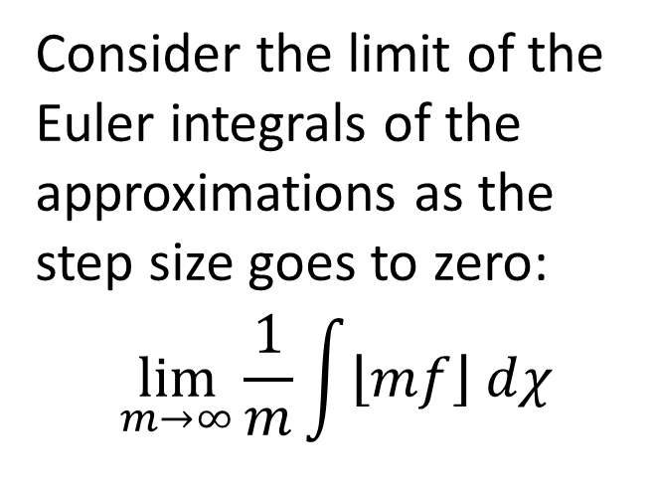


What is the Euler integral of a continuous function $f: ℝ→ℝ$?
Idea: Approximate $f$ by step functions.
Make the step size smaller.
$$f$$
3
$$\left\lfloor f \right\rfloor$$
Consider the limit of the Euler integrals of the approximations as the step size goes to zero:
$$\lim_{m→∞}{\frac{1}{m}\int{\left\lfloor mf\right\rfloor dχ}}$$
$\frac{1}{2}$∙$\left\lfloor 2f \right\rfloor$
2
1
$$x$$
Does it matter if we use lower or upper approximations?

Slide 19

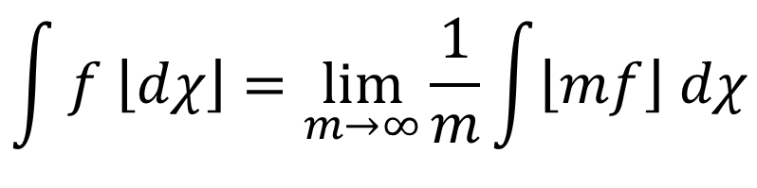

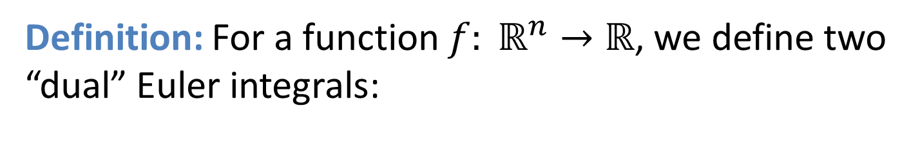

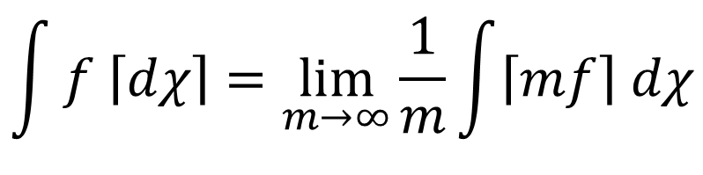

Definition: For a function $f: ℝ^{n}→ℝ$, we define two “dual” Euler integrals:
Lower Euler integral:
$$f$$
$\frac{1}{m}\left\lfloor mf\right\rfloor$
$$\int{f \left\lfloor dχ\right\rfloor }=\lim_{m→∞}{\frac{1}{m}\int{\left\lfloor mf\right\rfloor dχ}}$$
$$x$$
Upper integral:
$$f$$
$\frac{1}{m}\left\lceil mf\right\rceil$
$$\int{f \left\lceil dχ\right\rceil }=\lim_{m→∞}{\frac{1}{m}\int{\left\lceil mf\right\rceil dχ}}$$
$$x$$
These limits exist, but are not equal in general.

Slide 20

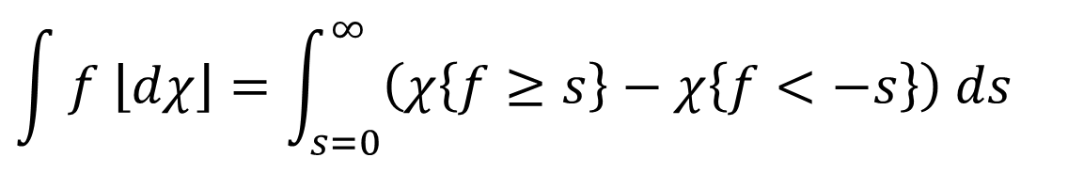



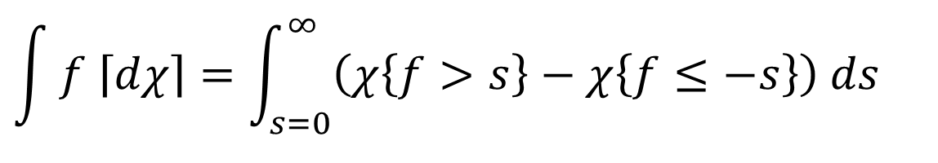
Theorem: The lower and upper Euler integrals can be expressed in terms of Riemann integrals:
$$\int{f \left\lfloor dχ\right\rfloor }=\int_{s=0}^{∞}{\left(χ\left\{f≥s\right\}−χ\left\{f<−s\right\}\right) ds}$$
lower:
$$f$$
$$s$$
$$x$$
$$−s$$
$$\int{f \left\lceil dχ\right\rceil }=\int_{s=0}^{∞}{\left(χ\left\{f>s\right\}−χ\left\{f≤−s\right\}\right) ds}$$
upper:

Slide 21
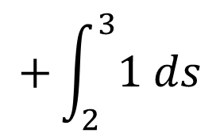

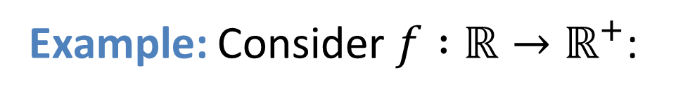
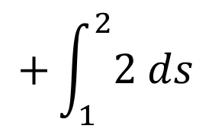


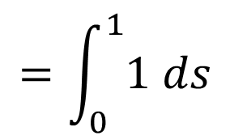
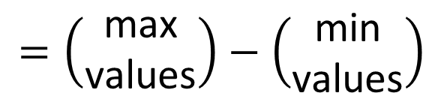
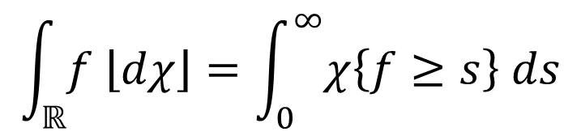





Example: Consider $f :ℝ→ℝ^{+}$:
$$\int_{ℝ}^{ }{f \left\lfloor dχ\right\rfloor }=\int_{0}^{∞}{χ\left\{f≥s\right\} ds}$$
3
$$=\int_{0}^{1}{1 ds}$$
$$+\int_{1}^{2}{2 ds}$$
$$+\int_{2}^{3}{1 ds}$$
$$=4$$
2
The Euler integral depends only on the critical points of $f$.
1
$$x$$
$$\int_{ℝ}^{ }{f \left\lfloor dχ\right\rfloor }$$
$$=\left(\begin{aligned}\text{max} \\ \text{values}\end{aligned}\right)−\left(\begin{aligned}\text{m}\text{in} \\ \text{values}\end{aligned}\right)$$
$$=3$$
$$− 1$$
$$+ 2$$
$$=4$$

Slide 22



In general: Suppose $f :ℝ^{n}→ℝ$ is a Morse function. Let $C(f)$ be the set of critical points of $f$, and let $i(p)$ denote the Morse index of a critical point $p$.
Example:
Morse index:
0
1
2
Then:
$$\int{f \left\lfloor dχ\right\rfloor }=\sum_{p∈C\left(f\right)}{{\left(−1\right)}^{n−i\left(p\right)}f\left(p\right)}$$
$$\int{f \left\lceil dχ\right\rceil }=\sum_{p∈C\left(f\right)}{{\left(−1\right)}^{i\left(p\right)}f\left(p\right)}$$

Slide 23



The Euler integral is a valuation on functions.
$$\int{f∨g dχ}+\int{f∧g dχ}=\int{f dχ}+\int{g dχ}$$
Additive:
Euclidean-invariant: Euclidean motions of the domain of $f$ do not change $∫f dχ$.
Continuous: A “small” change to $f$ results in a “small” change to $∫f dχ$.

Slide 24



We can also define integrals with respect to the intrinsic volumes; we call these Hadwiger integrals.
Let $f : ℝ^{n}→ℤ$ have finite range. Integration of $f$ with respect to $μ_{k}$ is straightforward:
$$\int_{ℝ^{n}}^{ }{f dμ_{k}}=\sum_{c}^{ }{c μ_{k}\{f=c\}}$$
Integration of $f : ℝ^{n}→ℝ$ is more complicated:
$$\int_{ℝ^{n}}^{ }{f \left\lfloor dμ_{k}\right\rfloor }=\lim_{m→∞}{\frac{1}{m}\int_{ℝ^{n}}^{ }{\left\lfloor mf\right\rfloor dμ_{k}}}$$
Lower integral:
$$\int_{ℝ^{n}}^{ }{f \left\lceil dμ_{k}\right\rceil }=\lim_{m→∞}{\frac{1}{m}\int_{ℝ^{n}}^{ }{\left\lceil mf\right\rceil dμ_{k}}}$$
Upper integral:

Slide 25







Hadwiger integrals can be expressed in various ways:
Let $X⊆ℝ^{n}$ be compact and $f :X→ℝ^{+}$ bounded.
$$\int{f \left\lfloor dμk\right\rfloor }=\int{μk\left\{ f ≥ s\right\} ds}= \int{ \int{f dχ dγ}}$$
∞
X
s = 0
$$A_{n,n−k}$$
$$P∩X$$
level sets
slices
ℝ
ℝ
$$f$$
$$f$$
$$ℝ^{n}$$
$$ℝ^{n}$$

Slide 26









Example: Let $f\left(x,y\right)=4−x^{2}−y^{2}$
on $X=\left\{\left(x,y\right) | x^{2}−y^{2}≤4\right\}$.
Excursion set $\left\{f≥s\right\}$ is a circle of radius $\sqrt{4−s}$.
ℝ
$$f$$
Hadwiger Integrals:
$$\int_{X}^{ }{f \left\lfloor dμ_{0}\right\rfloor }=\int_{0}^{4}{1 ds}=4$$
$$s$$
$$\int_{X}^{ }{f \left\lfloor dμ_{1}\right\rfloor }=\int_{0}^{4}{π\sqrt{4−s} ds}=\frac{16π}{3}$$
$$X$$
$$ℝ^{2}$$
$$\int_{X}^{ }{f \left\lfloor dμ_{2}\right\rfloor }=\int_{0}^{4}{π(4−s) ds}=8π$$

Slide 27

We obtain a functional version of the classic Hadwiger Theorem:
Theorem: Any Euclidean-invariant, continuous valuation $v$ on “tame” functions can be written
$$v\left(f\right)=\sum_{k=0}^{n}{\int_{ℝ^{n}}^{ }{c_{k}\left(f\right) dμ_{k}}}$$
for some increasing functions $c_{k}: ℝ→ℝ$.
Baryshnikov, Ghrist, Wright
That is, any valuation on functions can be written as a sum of Hadwiger integrals.

Slide 28


How can we measure the size of a function?
$$\int{f \left\lfloor dμ_{k}\right\rfloor }$$
and
$$\int{f \left\lceil dμ_{k}\right\rceil }$$

Slide 29



$$2$$
$$1$$
Applications and Challenges
$$x$$

Slide 30



Suppose we have a set of objects and a function $f$ that counts the number of objects at each point.
$$f$$
1
3
2
1
Hadwiger integrals provide data about the set of objects:
$\int{f dμ_{0}}$ gives a count
$\int{f dμ_{1}}$ gives a “length”
$\int{f dμ_{2}}$ gives an “area”
etc.
0
4
3
2
1
2
0
2
1
0
2
1
1
3
4
1
3
2
2
3
2
1
2
1
1
0

Slide 31











Example: Euler integral of $f$
compute:
$$\int{f dχ}$$
$$=\sum_{s=1}^{∞}{χ\{f≥s\}}$$
$$f$$
1
3
3
2
1
0
4
6
3
$$χ\left\{f≥1\right\}=−1$$
2
2
2
1
0
2
1
$$χ\left\{f≥2\right\}=3$$
0
2
$$\left\{f≥2\right\}$$
1
$$\left\{f≥4\right\}$$
1
1
3
4
1
$$χ\left\{f≥3\right\}=3$$
$$\left\{f≥3\right\}$$
3
$$\left\{f≥1\right\}$$
7
2
$$χ\left\{f≥4\right\}=2$$
4
3
2
2
$$\int{f dχ}=7$$
1
2
sum
5
1
1
0
There are 7 objects!

Slide 32





Proposition: For subsets $\{U_{i}\}$ of $X⊆ℝ^{n}$ and counting function $f:X→ℤ$, the Hadwiger integral with respect to $μ_{k}$ gives the sum of the intrinsic volumes $μ_{k}\left(U_{i}\right)$. That is:
$$\int_{X}^{ }{f dμ_{k}}=\sum_{i}{μ_{k}\left(U_{i}\right)}.$$
Proof:
$$\int_{X}^{ }{f dμ_{k}}=\int_{X}^{ }{\sum_{i}{1_{U_{i}}}dμ_{k}}$$
$$=\sum_{i}{\int_{X}^{ }{1_{U_{i}}dμ_{k}}}$$
$$=\sum_{i}{μ_{k}\left(U_{i}\right)}$$
In particular, if $μ_{k}\left(U_{i}\right)=c$ is constant for all $i$, then:
$$\frac{1}{c}\int_{X}^{ }{f dμ_{k}=\#\left\{U_{i}\right\}}.$$

Slide 33








These sets each have Euler characteristic $μ_{0}\left(U_{i}\right)=1$:
$$U_{6}$$
Therefore:
$$\int{f dμ_{0}}=\#\left\{U_{i}\right\}.$$
$$U_{3}$$
$$U_{2}$$
$$U_{1}$$
$$U_{7}$$
$$U_{4}$$
Application: Euler integration is useful for target enumeration (Baryshnikov and Ghrist).
$$U_{5}$$

Slide 34







Can we count by sensors?
$$\int{f dχ}=\sum_{s=1}^{∞}{χ\{f≥s\}}$$
$$χ\left\{f≥1\right\}=$$
???
$$f=0$$
$$f=3$$
$$f=1$$
$$f=4$$
$$f=2$$

Slide 35






Theorem: For a “tame” function $f: ℝ^{2}→ℤ$,
$$\int_{ℝ^{2}}^{ }{f dχ}=\sum_{s=0}^{∞}{\left(β_{0}\left\{f≥s\right\}−β_{0}\left\{f<s\right\}+1\right)}$$
where $β_{0}$ denotes the zeroth Betti number, the number of connected components of the set.
Proof:
For $K⊂ℝ^{2}$ compact and nonempty:
by homological definition of Euler characteristic
$$χ\left(K\right)=\dim{H_{0}(K)}−\dim{H_{1}(K)}$$
$$=\dim{H_{0}(K)}−\left(\dim{H_{0}\left(K^{c}\right)}−1\right)$$
by Alexander duality
With $K=\{f≥s\}$, we obtain:
$$\int{f dχ}=\sum_{s=1}^{∞}{χ\{f≥s\}}$$
$$=\sum_{s=1}^{∞}{\left(β_{0}\left\{f≥s\right\}−β_{0}\left\{ f<s\right\}+1\right)}$$

Slide 36



























$$\int_{ℝ^{2}}^{ }{f dχ}=\sum_{s=1}^{∞}{\left(β_{0}\left\{f≥s\right\}−β_{0}\left\{f<s\right\}+1\right)}$$
Computation:
$$=1$$
$$− 3$$
$$+ 1$$
$$+ 3$$
$$− 1$$
$$+ 1$$
$$+ 3$$
$$− 1$$
$$+ 1$$
$$+ 2$$
$$− 1$$
$$+ 1$$
$$=7$$
$$β_{0}\left\{f<3\right\}=1$$
$$β_{0}\left\{f<4\right\}=1$$
$$β_{0}\left\{f≥4\right\}=2$$
$$β_{0}\left\{f≥3\right\}=3$$
$$β_{0}\left\{f<2\right\}=1$$
$$β_{0}\left\{f≥1\right\}=1$$
$$β_{0}\left\{f≥2\right\}=3$$
$$β_{0}\left\{f<1\right\}=3$$
$$f=0$$
$$f=3$$
$$f=1$$
$$f=4$$
$$f=2$$

Slide 37

How can we compute the other Hadwiger integrals in a network context?
This is challenging if $k>0$ because:
$μ_{k}$ cannot be reduced to connectivity
we need metric information to compute $μ_{k}$
$\int{f dμ_{k}}$ cannot be reduced to critical values of $f$
computing $\int{f dμ_{k}}$ given a discrete sampling of $f$ is difficult

Slide 38











Challenge: A change in a function $f$ on a small set (in the Lebesgue) sense can result in a large change in the Hadwiger integrals of $f$.
$$2$$
$$2$$
Similar examples exist for higher-dimensional Hadwiger integrals.
$$f$$
$$g$$
$$1$$
$$1$$
$$x$$
$$x$$
$$\int{f dχ}=1$$
$$\int{g dχ}=2$$
Working with Hadwiger integrals requires different intuition than working with Lebesgue integrals.

Slide 39






Challenge: How can we approximate the Hadwiger integrals of a function sampled at discrete points?
$$f:{\left[0,1\right]}^{2}→ℝ$$
triangulated approximations of $f$
Hadwiger integrals of interpolations of $f$ might diverge, even when the approximations converge pointwise to $f$.

Slide 40










Challenge: Non-linearity of Hadwiger integrals of continuous functions.
Consider the following Euler integrals:
$$y=1$$
$$1$$
$$1$$
$$1$$
$$y=x$$
$$y=1−x$$
$$x$$
$$x$$
$$x$$
$$\int{x \left\lfloor dχ\right\rfloor }=1$$
$$\int{(1−x) \left\lfloor dχ\right\rfloor }=1$$
$$\int{1 \left\lfloor dχ\right\rfloor }= 1$$
[0, 1]
[0, 1]
[0, 1]

Slide 41
Application: image processing
Intrinsic volumes are of utility in image processing.
A greyscale image can be viewed as a real-valued function on a planar domain.
With such a perspective, Hadwiger integrals may be useful to return information about an image.
Applications may also include color or hyperspectral images, or images on higher-dimensional domains.
K. Schladitz, J. Ohser, and W. Nagel. “Measuring Intrinsic Volumes in Digital 3d Images.” Discrete Geometry for Computer Images. Springer, 2006.

Slide 42



Application: cell dynamics
MacPherson and Srolovitz: As the cell structure changes by a certain process that minimizes energy, cell volumes change according to:
$$\frac{dμn}{dt}\left(C\right)=−2πM\left(μ_{n−2}\left(C_{n}\right)− \frac{1}{6}μ_{n−2}(C_{n−2})\right)$$
$n$-dimensional structure
$(n−2)$-dimensional structure

Slide 43
References
Yuliy Baryshnikov and Robert Ghrist. “Target Enumeration via Euler Characteristic Integration.” SIAM Journal on Applied Mathematics, vol. 70, no. 3 (2009), p. 825–844.
Yuliy Baryshnikov and Robert Ghrist. “Definable Euler integration.” Proceedings of the National Academy of Sciences. vol. 107, no. 21 (2010), p. 9525–9530.
Yuliy Baryshnikov, Robert Ghrist, and Matthew Wright. “Hadwiger’s Theorem for Definable Functions.” Advances in Mathematics. vol. 245 (2013), p. 573–586.
S. H. Shanuel. “What is the Length of a Potato?” Lecture Notes in Mathematics. Springer, 1986, p. 118–126.
Matthew Wright. “Hadwiger Integration of Definable Functions.” Publicly accessible Penn Dissertations. Paper 391. http://repository.upenn.edu/edissertations/391.

